Slide 1
Section G
RNA synthesis and processing
Guodong Yang
Biochemistry and Molecular Biology, College of Life Sciences
gdyang@sdau.edu.cn
13854808762
Notes:
RNA is the only macromolecule known to have a role both in the storage and transmission of
information and in catalysis, which has led to much speculation about its possible role as an essential
chemical intermediate in the development of life on this planet.
Many additional, specialized
RNAs have regulatory or catalytic functions or are precursors to the three main classes of RNA.
These special-function RNAs are no longer thought of as minor species in the catalog of cellular
RNAs. In vertebrates, RNAs that do not fit into one of the classical categories (mRNA, tRNA, rRNA)
seem to vastly outnumber those that do. （最后一句什么意思？）
7th p2156
The sum of all the RNA molecules produced in a cell under a given set of conditions is called the
cellular transcriptome. Given the relatively small fraction of the human genome devoted to proteincoding genes, we might expect that only a small part of the human genome is transcribed. This is not
the case. Modern analyses of transcription patterns have revealed that much of the genome of humans
and other mammals is transcribed into RNA. The products are predominantly not mRNAs, tRNAs, or
rRNAs, but rather special-function RNAs, a host of which are being discovered. Many of these seem
to be involved in regulation of gene expression; 7th p2157
问题：in E.coli，三种RNA都是由一种RNA polymerase合成的吗？

Slide 2
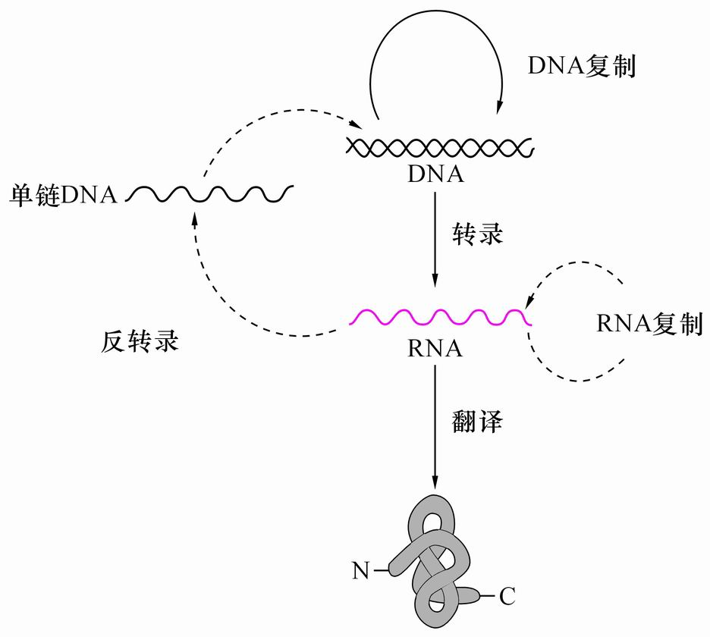
Genetic Central Dogma
遗传中心法则

Slide 3
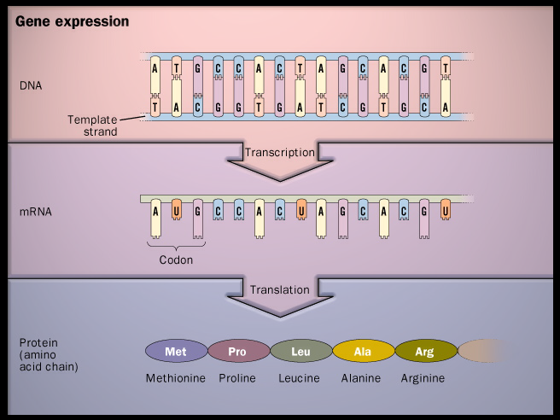
Notes:
N6-methyladenosine也叫m6A，是一种广泛存在于mRNA上的碱基修饰行为，mRNA的内部修饰则用于维持mRNA的稳定性。

Slide 4
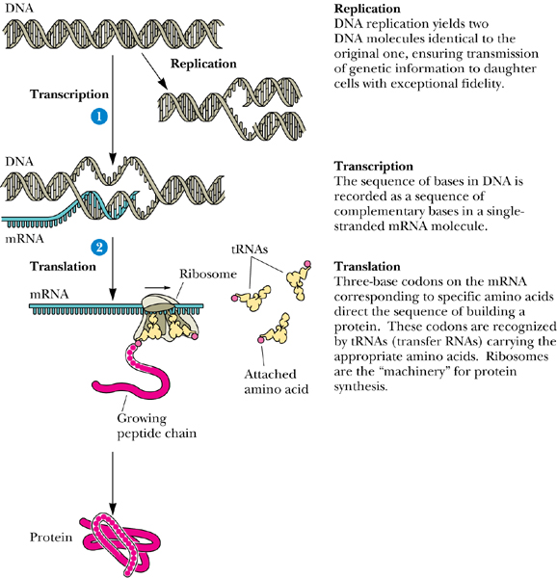

Slide 5
G1 RNA structure: tRNA cloverleaf
G2 RNA Transcription in Prokaryotes
G3 The Lac operon
G5,G6 Transcription in Eukaryotes
G7 Processing of eukaryotic pre-mRNA
G8,G9 Ribosomal RNA, tRNA
Notes:
Summary of RNA transcription
G1 RNA structure: tRNA cloverleaf （F章节已经讲过，没有重点内容）
G2 RNA Transcription in Prokaryotes （主要讲RNA聚合酶、promoter（如何开始转录），及转录的过程）
1. similar and different aspects between DNA replication
and RNA transcription
2. RNA polymerase
3. transcriptional bubble
4. promoter
5. RNA transcription: initiation, elongation, termination
G3 the Lac operon（两个转录调控模型，Lac operon，Trp operon，先讲清楚基因表达的所需条件，再讲清楚调控过程）
G5,G6 Transcription in Eukaryotes
1. Three RNA polymerases
2. Pol II binding promoter, transcription factor
G8 Processing of eukaryotic pre-mRNA
1. mRNA processing
2. rRNA processing
3. tRNA processing

Slide 6
G1 RNA structure

Slide 7
RNA molecules do not form simple, regular secondary structure but many form complex and unique three dimensional structures. (G1)
1. Single strand RNA tends to take right-handed helical conformation.
2. Self-complementary sequences on a RNA molecule lead to specific structures.
3. The standard base-pairing rules are followed (i.e., A with U, G with C).
4. Intrastrand base pairing makes structures including internal loops, and hairpins (helical).
Notes:
molecule
英 [ˈmɒlɪkju:l] 美 [ˈmɑlɪkjul]
molecules
英 ['mɒlɪkju:lz] 美 ['mɒlɪkjulz]

Slide 8
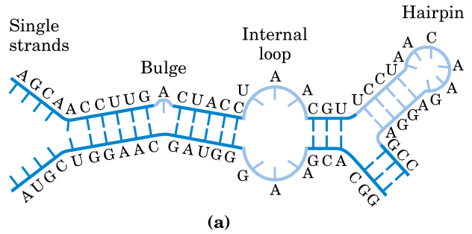

Slide 9
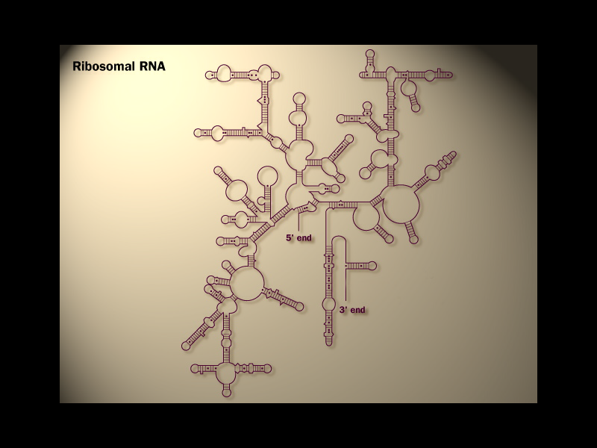

Slide 10
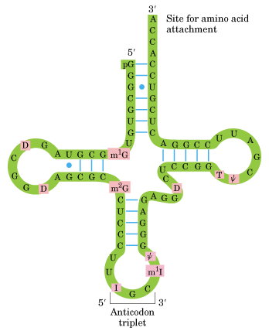

Amino acid arm
D arm
Stem
TψC arm
loop
anticodon arm
cloverleaf in secondary

Slide 11
RNA Transcription in Prokaryotes (G2)

Slide 12
1. DNA and RNA syntheses are similar in some aspects but different in others
Similar in fundamental chemical mechanism:
both are guided by a template;
both have the same polarity in strand extension (5` to 3`);
both use triphosphate nucleotides (dNTP or NTP).
Notes:
chemical
英 [ˈkemɪkl] 美 [ˈkɛmɪkəl]
adj. 化学的； 用化学方法制造的，化学作用的；
n. 化学药品，化学制品；

Slide 13
Different aspects:
Needs no primers;
Only involves a short segment of a large DNA molecule;
Uses only one of the two complementary DNA strands as the template strand;
Has no proofreading activities;
Be subject to great variation.
Notes:
RNA polymerases lack a separate proofreading 3′ → 5′ exonuclease active site (such as that of
many DNA polymerases), and the error rate for transcription is higher than that for chromosomal
DNA replication—approximately one error for every 10⁴ to 10⁵ ribonucleotides incorporated into
RNA.
Many RNA polymerases, including bacterial RNA polymerase and the eukaryotic RNA polymerase II (discussed below), do pause when
a mispaired base is added during transcription, and they can remove mismatched nucleotides from the
3′ end of a transcript by direct reversal of the polymerase reaction. But we do not yet know whether
this activity is a true proofreading function and to what extent it may contribute to the fidelity of
transcription.
7th –p2161

Slide 14
2. The multimeric RNA polymerase in E.coli has multiple functions
The holoenzyme consists of five types (五种，六个）of subunits (α₂ββ’ω σ)and its is used to synthesize all the RNA molecules in E. coli.
The multiple functions include:
  searches for initiation sites on the DNA molecule and unwinds a short stretch of DNA (initiation);
  selects the correct NTP and catalyzes the formation of phosphodiester bonds (elongation);
  detects termination signals for RNA synthesis (termination).
Notes:
Σ Σ
Initiation, elongation主要由RNA polymerase去识别，而termination主要依赖RNA或者其它的蛋白。（见后面转录的终止）

Slide 15
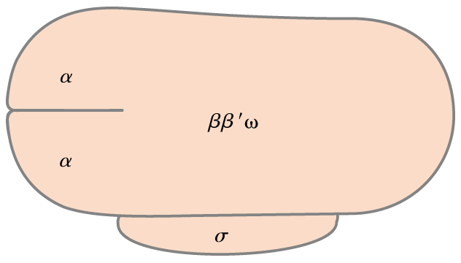
Possible catalytic subunits
promoter recognition,
activator binding
151 155
11 kDa
36.5 kDa
Promoter
specificity
(32-90 kDa)
The E. coli RNA polymerase holoenzyme consists of
six subunits: α₂ββ’ω σ.

Slide 16
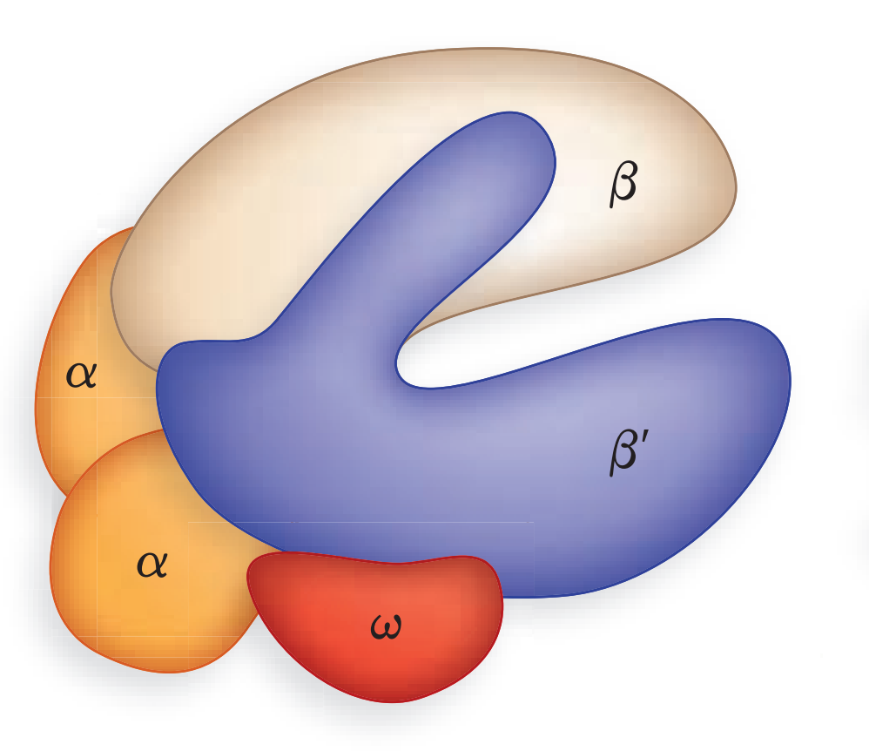

core enzyme
five core subunits
Notes:
FIGURE 26-4 Structure of the RNA polymerase holoenzyme of the bacterium Thermus aquaticus. The overall
structure of this enzyme is very similar to that of the E. coli RNA polymerase; no DNA or RNA is shown here.
7^{thp}-2161

Slide 17
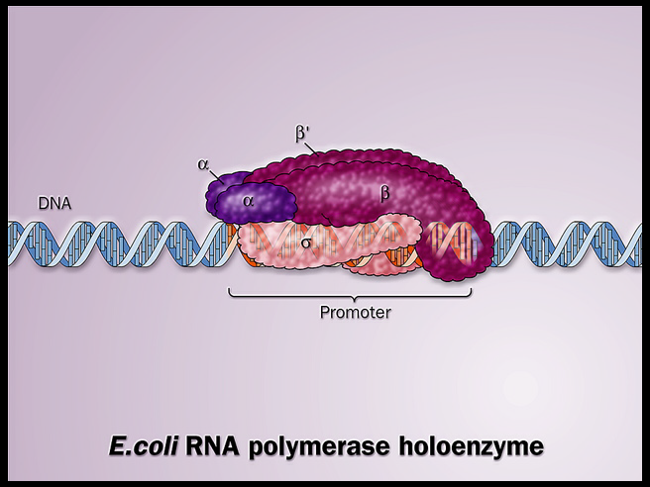
Notes:
In E. coli, RNA polymerase binding occurs within a region stretching from about 70 bp before the
transcription start site to about 30 bp beyond it.
The promoter region thus extends between positions -70 and +30.
7th p2162
-

Slide 18
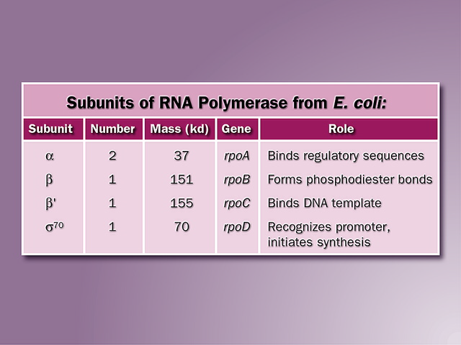

Slide 19
3. RNA synthesis occurs in a “moving” transcription bubble on the DNA template

Slide 20
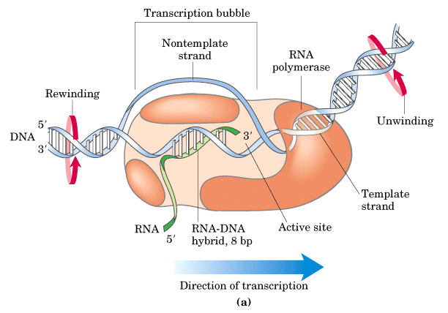
Notes:
The 5′-triphosphate group of the first residue in a nascent (newly formed) RNA
molecule is not cleaved to release PPi, but instead remains intact throughout the transcription process.
During the elongation phase of transcription, the growing end of the new RNA strand base-pairs
temporarily with the DNA template to form a short hybrid RNA-DNA double helix, about 8 bp long.
To enable RNA polymerase to synthesize an RNA strand complementary to one of the DNA
strands, the DNA duplex must unwind over a short distance, forming a transcription “bubble.” During
transcription, the E. coli RNA polymerase generally keeps about 17 bp unwound. The 8 bp RNADNA hybrid occurs in this unwound region.
Elongation of a transcript by E. coli RNA polymerase proceeds at a rate of 50 to 90 nucleotides/s.
-7th p2160

Slide 21
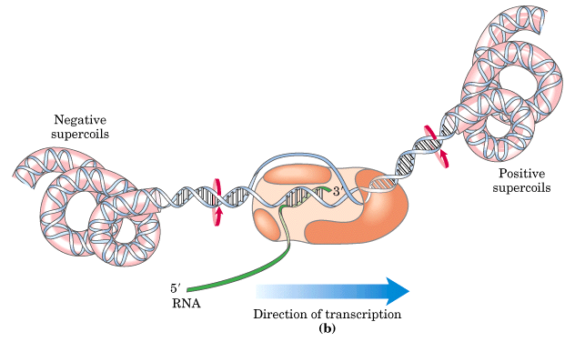

Slide 22
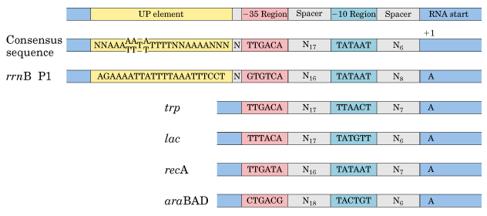
4. RNA polymerase recognizes specific promoter sequences on DNA to initiate transcription
Promoter sequences are located adjacent to genes.
Promoters have two consensus sequences centered at –10 and –35 positions (the first residue of the RNA is given +1).
TSS
Transcription start site

Slide 23
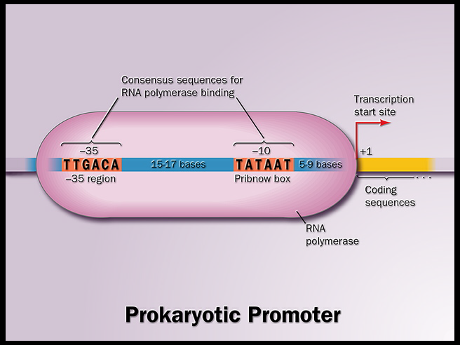
TSS

Slide 24
the –10 sequence, TATAAT (the Pribnow box)
the –35 consensus region, TTGACA

Slide 25
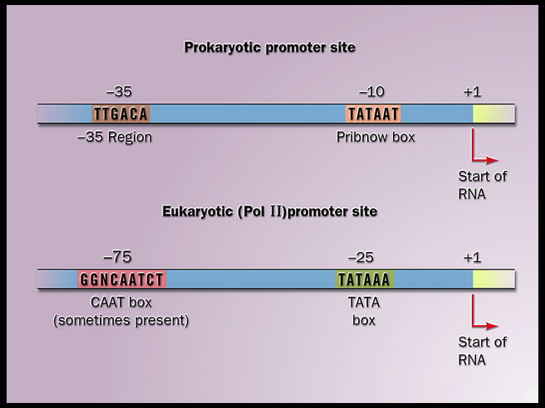

Slide 26
5. The σ subunits enable the E.coli RNA polymerase to recognize specific promoter sites
The RNA polymerase without the σ subunit (i.e., the α₂ββ’ω, core enzyme) is unable to start transcription at a promoter.
Promoter vary up to 1000-fold in their efficiency of initiation which depends on the exact sequence of the key promoter elements as well as flanking sequences.

Slide 27
Three stages of transcription
  Initiation
  Elongation
  Termination
Notes:
Σ Σ

Slide 28
6. RNA polymerase unwinds the template DNA then initiate RNA synthesis -Initiation
The enzyme slides to a promoter region and forms a more tightly bound “closed complex”.
Then the polymerase-promoter complex has to be converted to an “open complex”, in which a 12-15 bp covering the region from the AT-rich –10 site to +3 site is unwound.
The essential transition from a “closed” to an “open” complex sets the stage for RNA synthesis, after which the core polymerase moves away from the promoter.

Slide 29
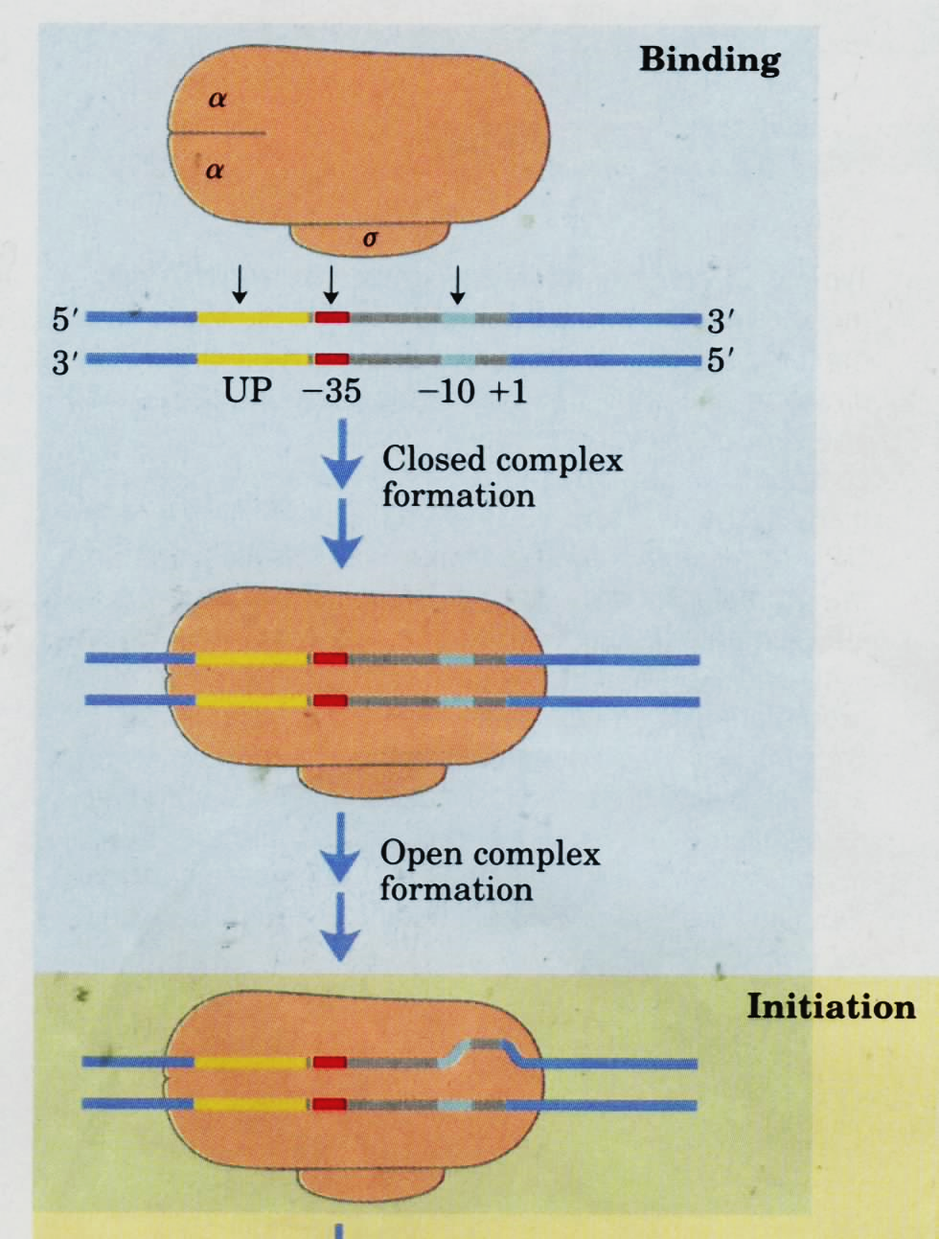
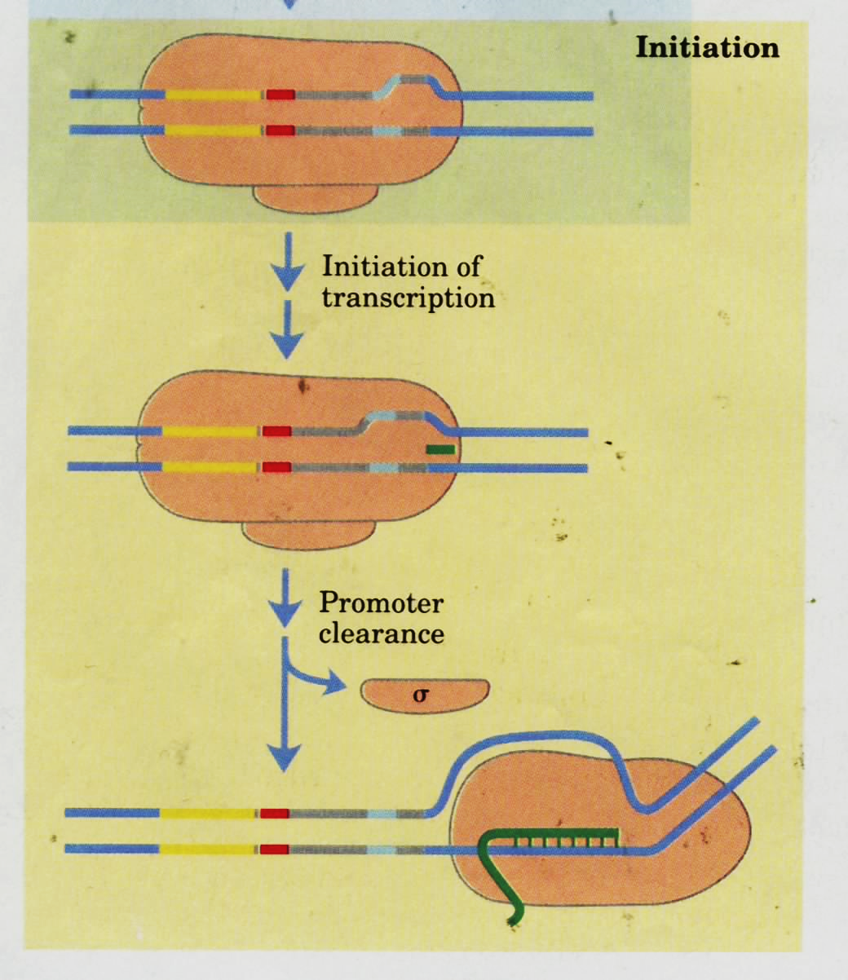

Slide 30
7. After initiation, the factor σ is released to leave the core enzyme which continues elongation
The core enzyme (α₂ββ’ω) continues elongation of the RNA transcript. The RNA synthesizes RNA in the 5’——3’ direction, using the four ribonucleoside 5’ triphosphates (ATP, GTP, CTP, UTP) as precursors.

Slide 31
Ternary complex
Sense strand
Antisense strand

Slide 32
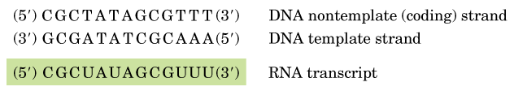
Sense strand
Antisense strand

Slide 33
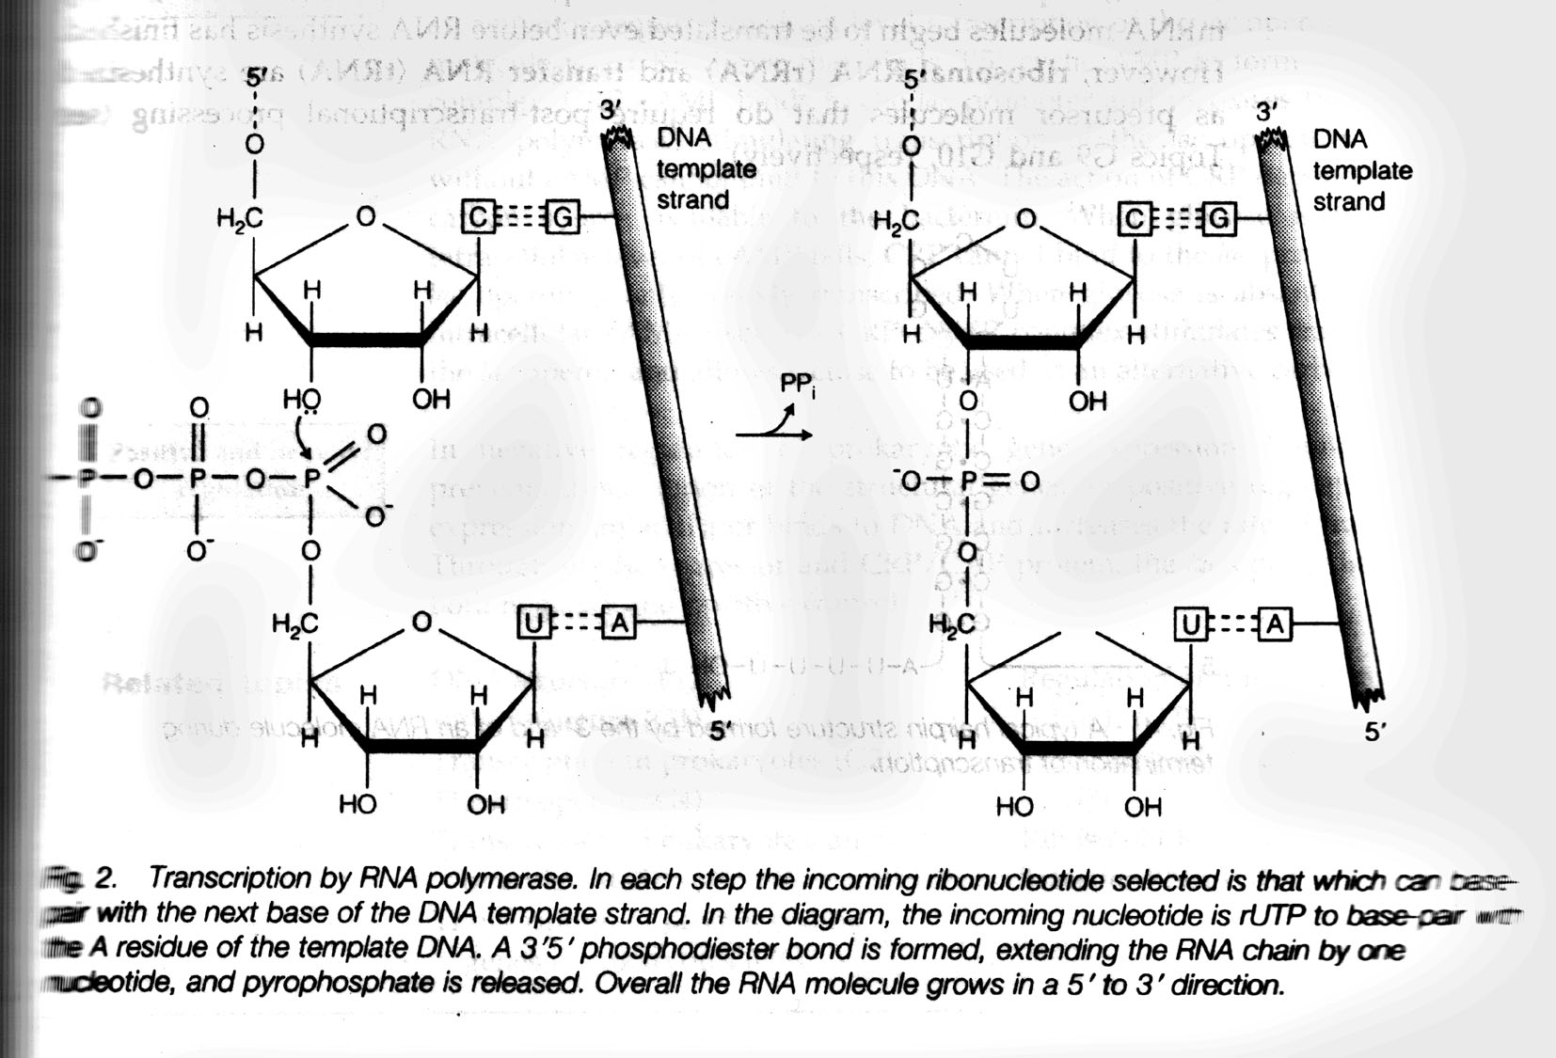

Slide 34
8. E.coli RNA polymerase stops synthesizing RNA at specific terminator DNA sequences -Termination
A common termination signal is a hairpin structure formed by a palindromic GC-rich region, followed by an AT-rich sequence.
Other signals are also used which require the assistance of ρ protein for effective termination.
Notes:
palindromic sequence回文顺序
palindromic
英 [ˌpælɪn'drɒmɪk] 美 [ˌpælɪn'drɒmɪk]
Palindrom 回文结构

Slide 35
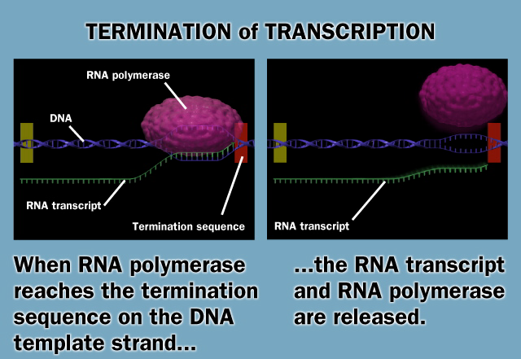

Slide 36
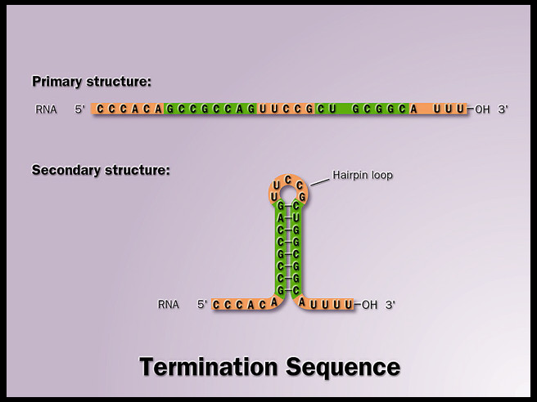
Palindrome sequences
回文序列
G U
3’-C G G C G G U C G A C C G C C G -5’
Notes:
理解panlindrome sequences的三种方式
1，自己回折可以完全反向互补
2，两条链的序列成中心对称
3，两条链序列完全相同。

Slide 37
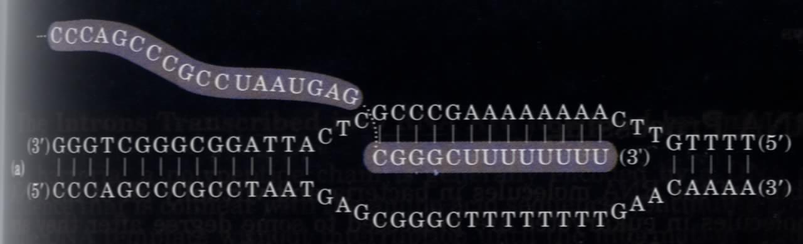
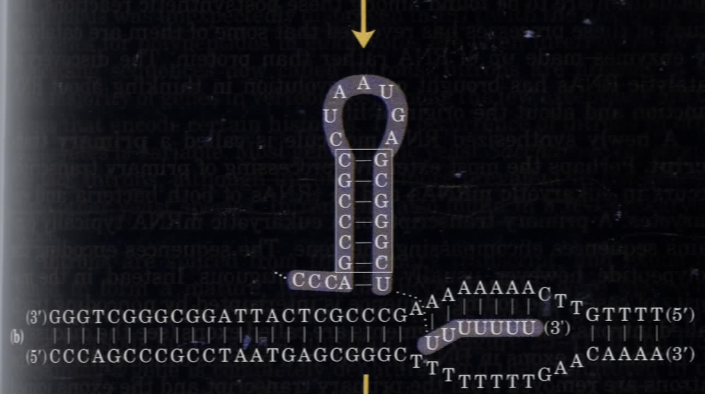
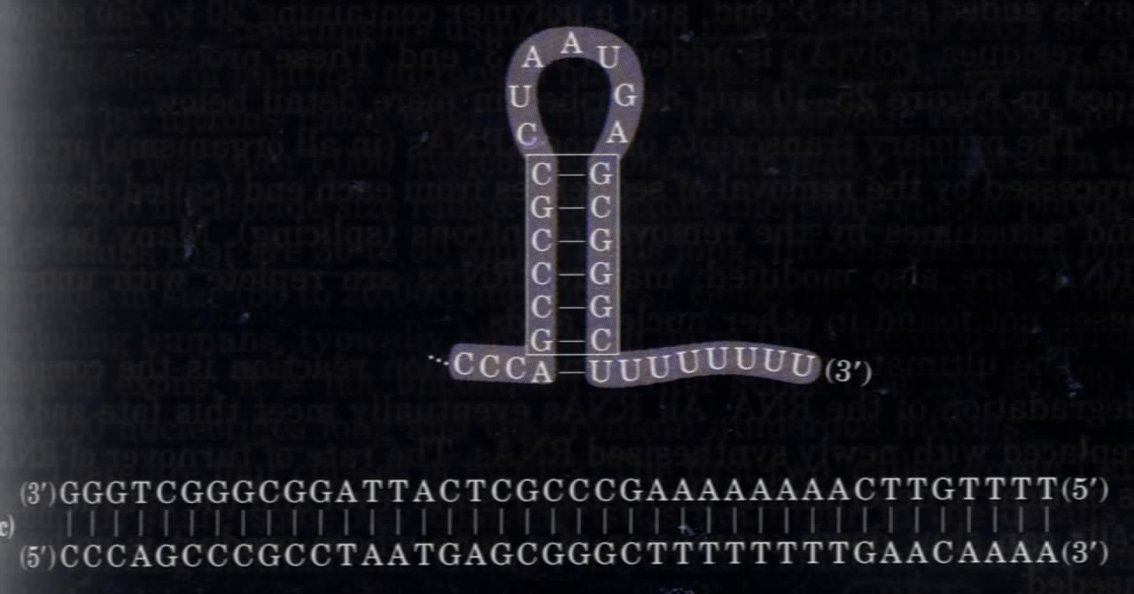
Palindrome DNA
sequences
ρ-independent
terminator: a model
Stem-loop
(hairpin) structure
Notes:
palindrome回文（指顺读和倒读都一样的词语）

Slide 38
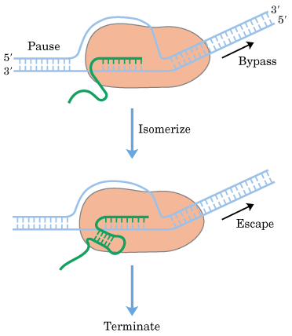
Notes:
isomerize
英 [aɪ'sɒməraɪz] 美 [aɪ'sɒməˌraɪz]

Slide 39
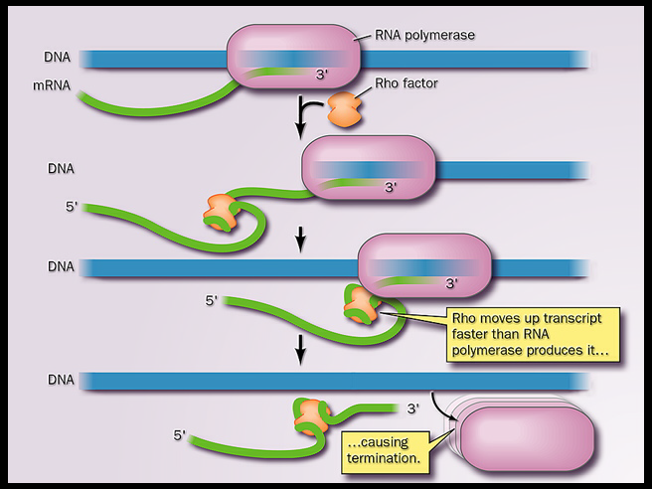
Notes:
The ρ-dependent terminators lack the sequence of repeated A residues in the template strand but
usually include a CA-rich sequence called a rut (rho utilization) element. The ρ protein associates
with the RNA at specific binding sites and migrates in the 5′ → 3′ direction until it reaches the
transcription complex that is paused at a termination site (Fig. 26-7b). Here it contributes to release
of the RNA transcript. The ρ protein has an ATP-dependent RNA-DNA helicase activity that
promotes translocation of the protein along the RNA, and ATP is hydrolyzed by the ρ protein during
the termination process. The detailed mechanism by which the protein promotes the release of the
RNA transcript is not known.
-7th p2168

Slide 40
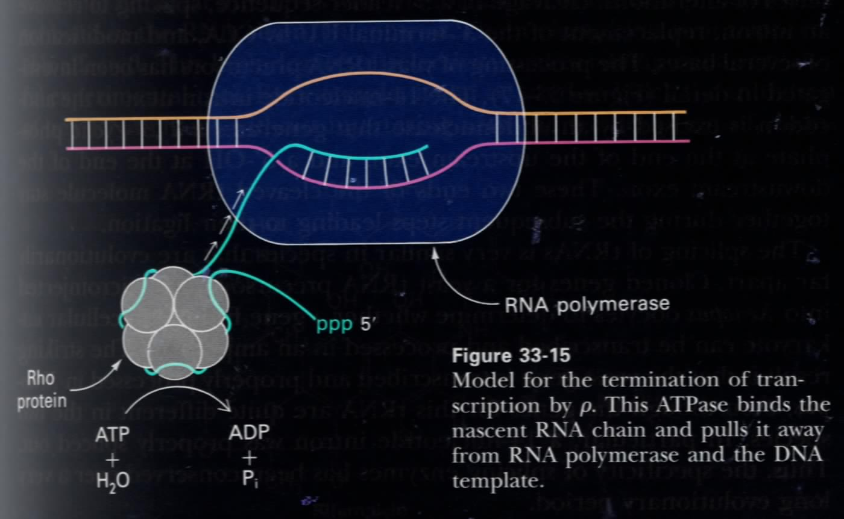
Model for an ρ-dependent terminator

Slide 41
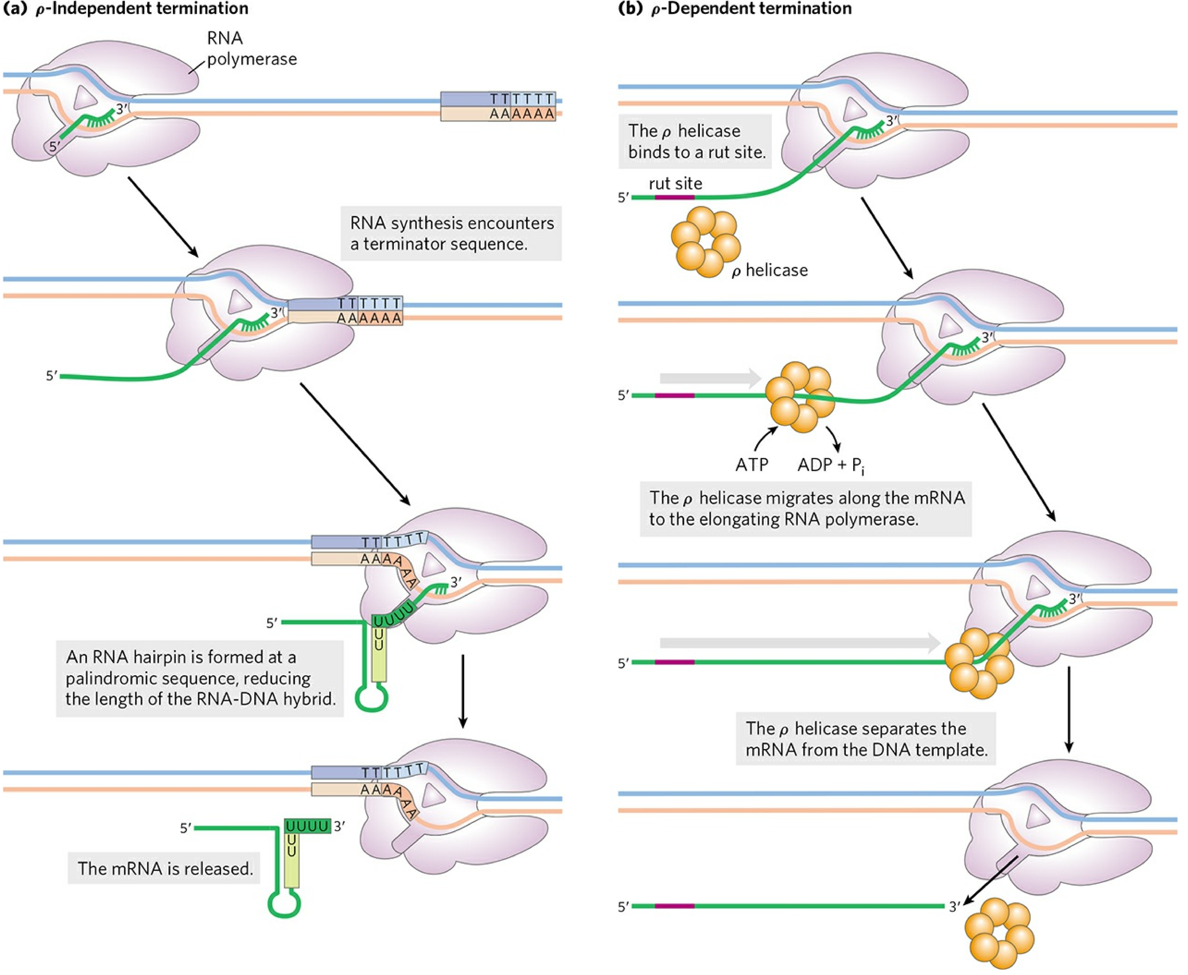
Notes:
7th 中，对p蛋白的假设没有重复 p2170
FIGURE 26-7 Termination of transcription in E. coli. (a) ρ-Independent termination. RNA polymerase pauses at a
variety of DNA sequences, some of which are terminators. One of two outcomes is then possible: either the polymerase
bypasses the site and continues on its way, or the complex undergoes a conformational change (isomerization). In the latter
case, intramolecular pairing of complementary sequences in the newly formed RNA transcript may form a hairpin that
disrupts the RNA-DNA hybrid or the interactions between RNA and polymerase, or both, resulting in isomerization. An
A=U hybrid region at the 3′ end of the new transcript is relatively unstable, and the RNA dissociates from the complex
completely, leading to termination. This is the usual outcome at terminators. At other pause sites, the complex may escape
after the isomerization step to continue RNA synthesis. (b) ρ-Dependent termination. RNAs that include a rut site (purple)
recruit the ρ helicase. The ρ helicase migrates along the mRNA in the 5′ → 3′ direction and separates it from the
polymerase

Slide 42
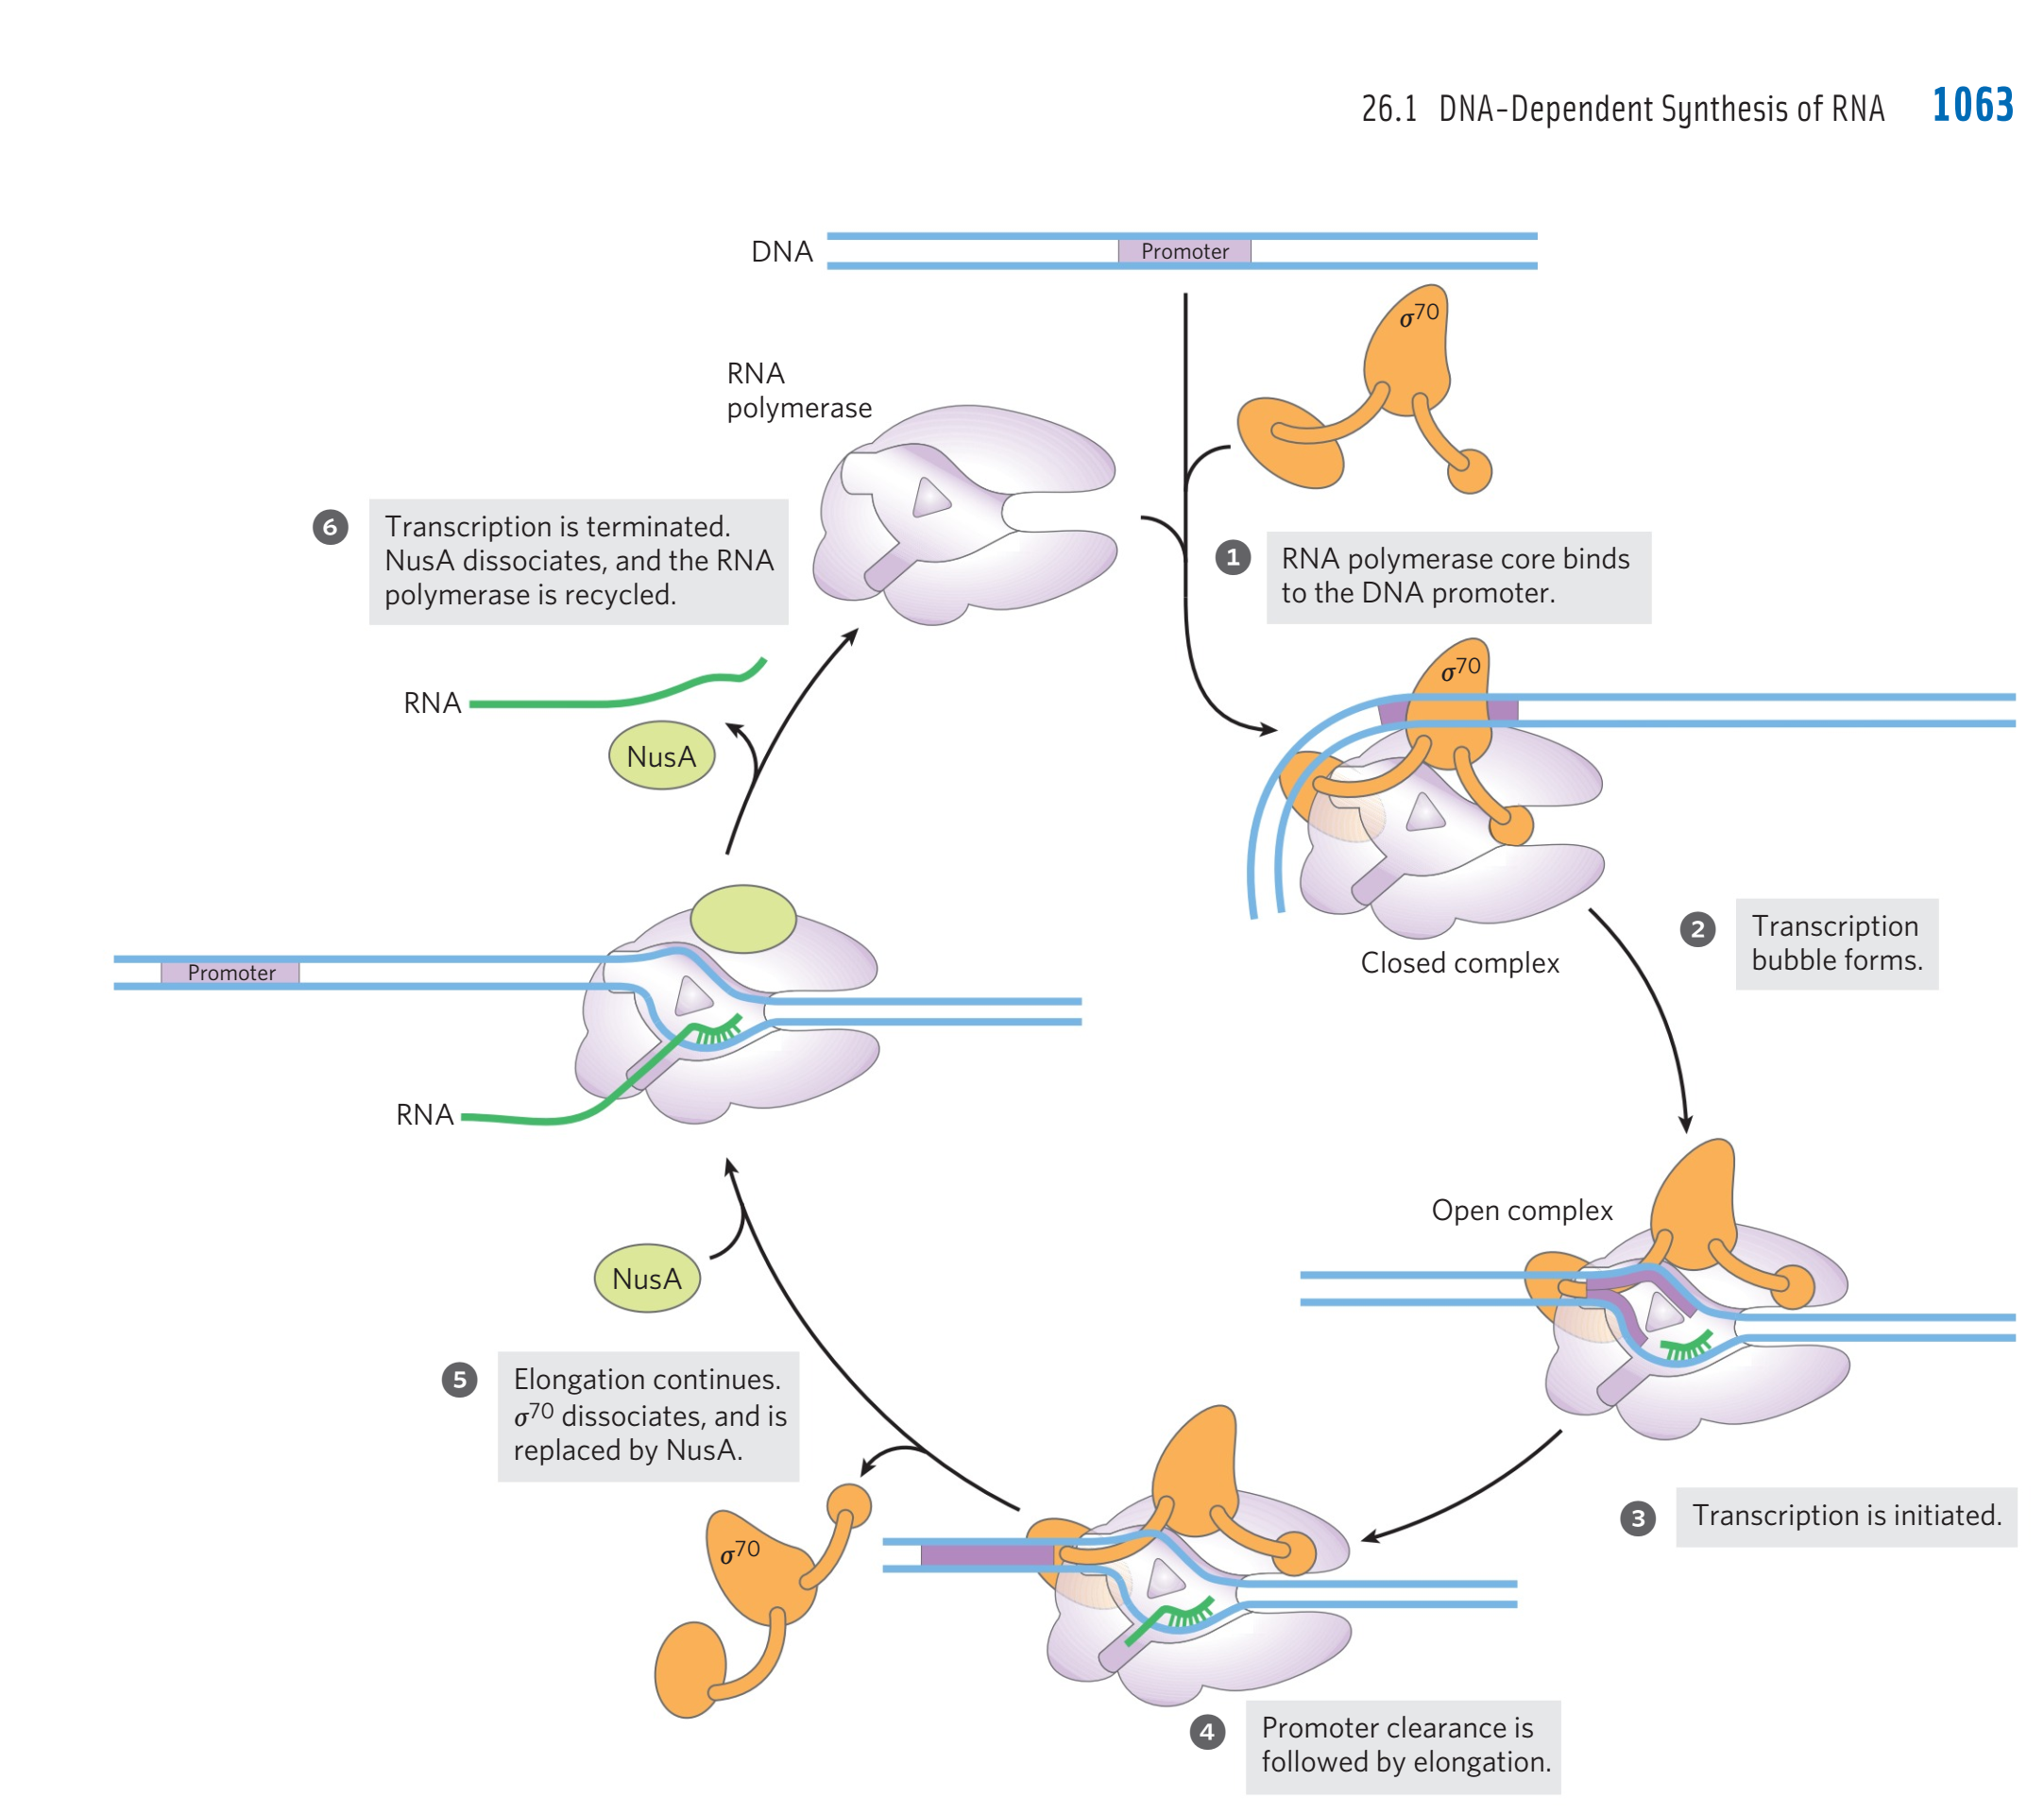
I initiation
III termination
II elongation
Notes:
The initiation phase encompasses transcription initiation and promoter clearance (steps 1 through 4 here).
The σ subunit is released and it is replaced by the protein NusA. The polymerase leaves the promoter and becomes committed to elongation of the RNA (step 5).
When transcription is complete, the RNA is released, the NusA protein dissociates, and theRNA polymerase dissociates from the DNA (step 6)
The protein NusA (Mr 54,430) binds to the elongating RNA polymerase, competitively with the σsubunit. Once transcription is complete, NusA dissociates from the enzyme,
the RNA polymerase dissociates from the DNA, and a σfactor (σ 70 or another) can again bind to the enzyme to initiate transcription.
NusA蛋白可以竞争性结合σ因子

Slide 43
9. RNA processing
In prokaryotes, RNA transcribed from protein-coding genes (messenger RNA, mRNA), requires little or no modification prior to translation
However, mRNA in eukaryotes, ribosomal RNA (rRNA) and transfer RNA (tRNA) are synthesized as precursor molecules that do require post-transcriptional processing（转录后加工）) (G8, G9, G10)
Notes:
Many of the RNA molecules in bacteria and virtually all RNA molecules in eukaryotes are processed
to some degree after synthesis.
7th –p2179

Slide 44
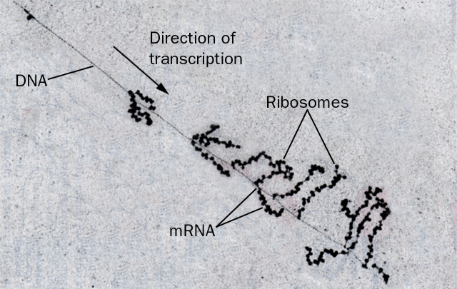
This E. coli gene is being simultaneously transcribed and translated
Notes:
simultaneously 英 [ˌsɪməl'teɪnɪəslɪ] 美 [saɪməlˈtenɪəslɪ] adv. 同时地; 一壁; 齐; 一齐

Slide 45
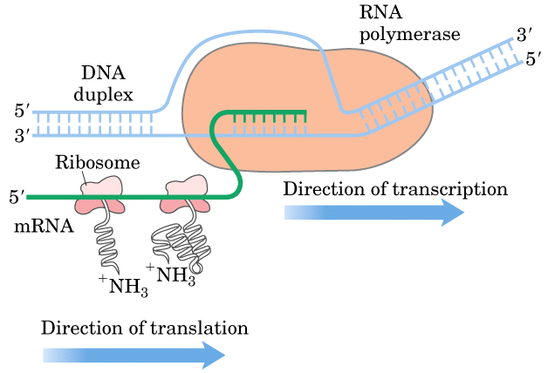
Notes:
45

Slide 46
顺反子（cistron）：
即结构基因，决定一条多肽链合成的功能单位。
单顺反子（monocistron）：
真核基因转录产物为单顺反子，即一个基因编码一条多肽链或RNA链，每个基因转录有各自的调节元件。
多顺反子（polycistron）：
在原核细胞中，通常是几种不同的mRNA连在一起，相互之间由一段短的不编码蛋白质的间隔序列所隔开，这种mRNA叫做多顺反子mRNA。
Notes:
cistron 英 ['sɪstrɒn] 美 ['sɪsˌtrɒn]

Slide 47
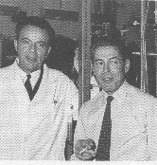
G3 The Lac Operon
操纵子学说
1、操纵子模型的提出
1961年，Monod和Jacob提出乳糖操纵子模型
获1965年诺贝尔生理学和医学奖
Notes:
Regulation of transcription

Slide 48
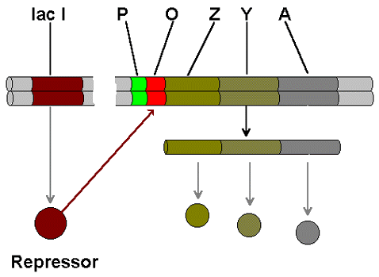
2、操纵子（operon）的定义
操纵子：是基因表达的协调单位，由启动子、操纵基因及其所控制的一组功能上相关的结构基因所组成。操纵基因受调节基因产物的控制。
T

Slide 49
操纵子模型（lac operon）
操纵子的基本组成元件包括：
启 动 子（promoter，P）
操纵基因（operator，O）
结构基因（structural gene(s)）
终 止 子 （terminator）
调节基因（regulatory gene）

Slide 50

Lac operon (乳糖操纵子）
β-半乳糖苷酶
β-半乳糖苷透过酶
乙酰基转移酶
β-galactosidase (Z),
galactoside permease (Y),
thiogalactoside transacetylase (A)

Slide 51
乳糖操纵子-正、负调控模型
调控区
结构基因
LacI
DNA
P
O
Z
Y
A
T
调节基因
P: Promoter 启动子
O： Operator操纵基因
Z： β-半乳糖苷酶
Y： β-半乳糖透过酶
A：乙酰基转移酶
T：Terminator终止子
操纵序列
启动序列
CAP结合位点
cAMP—CAP复合物

Slide 52
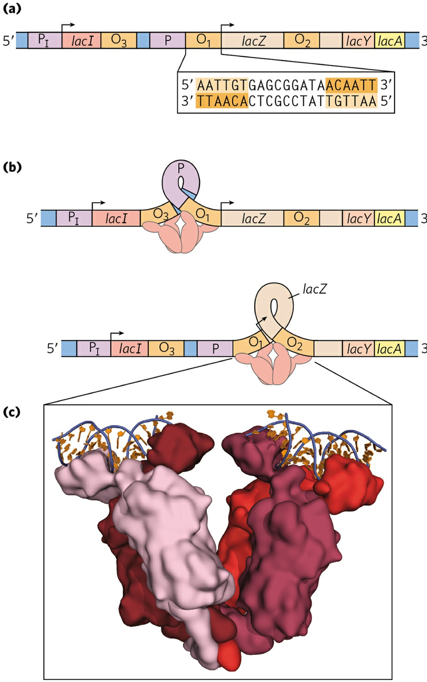
Notes:
The operator to which it binds most tightly (O1) abuts the transcription start site
(Fig. 28-8a). The I gene is transcribed from its own promoter (PI) independent of the lac operon
genes. The lac operon has two secondary binding sites for the Lac repressor, O2 and O3. O2 is
centered near position +410, within the gene encoding β-galactosidase (Z); O3 is near position -90,
7th p2356

Slide 53
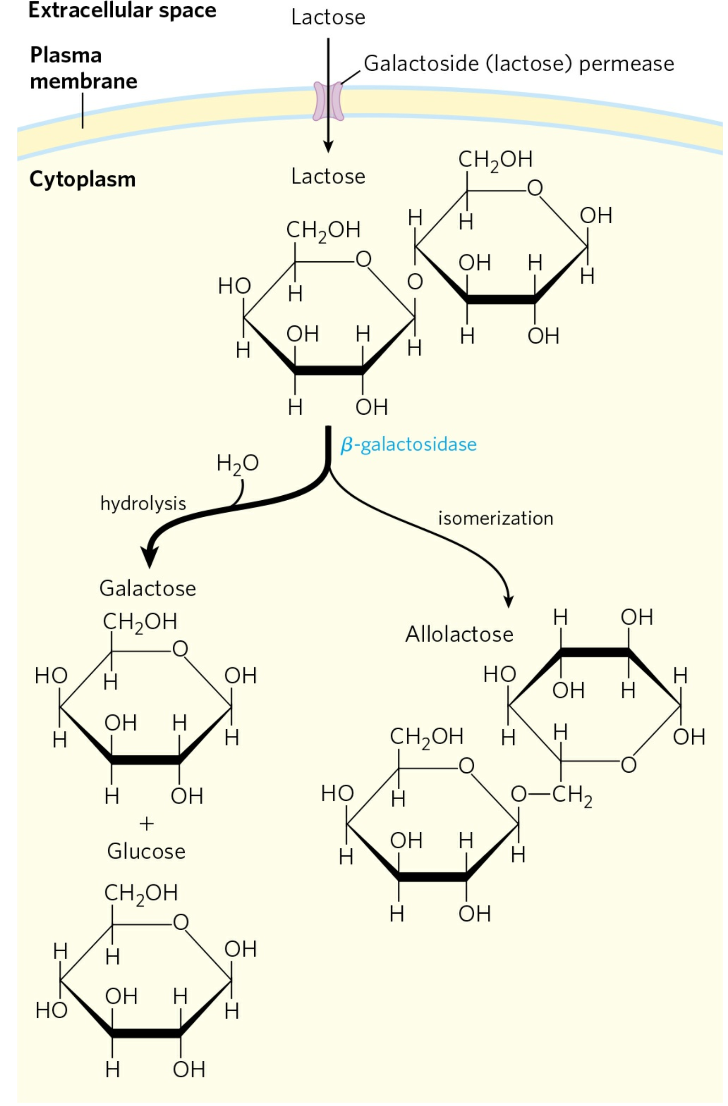
Lactose metabolism in E. coli.
Notes:
FIGURE 28-7 Lactose metabolism in E. coli. Uptake and metabolism of lactose require the activities of galactoside (lactose) permease and β-galactosidase. Conversion of lactose to allolactose by transglycosylation is a minor reaction also catalyzed by β-galactosidase.
The inducer in the lac operon system is not lactose itself but allolactose(异乳糖), an isomer of lactose (Fig. 28-7).

Slide 54
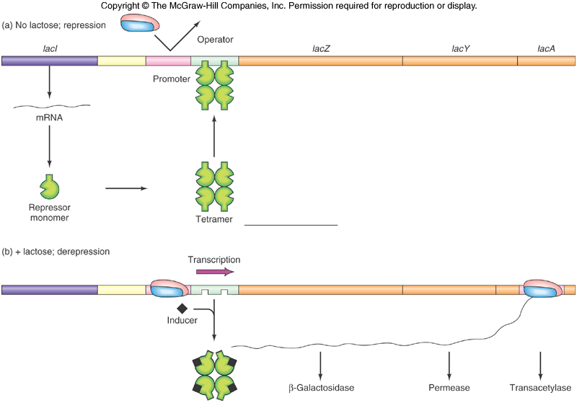
Negative Control of the lac Operon
7-54
Notes:
lactose
英 [ˈlæktəʊs] 美 [ˈlæktoʊs]
n. 乳糖；
Monomer, dimer, trimer, tetramer, pentamer, hexamer, heptamer, octamer , nonamer[ˈnɔnəmə]
Primary structure, secondary structure, tertiary structure, quarternary structure

Slide 55
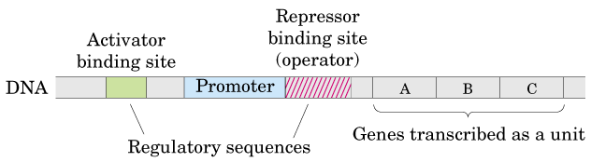
Notes:
55

Slide 56
cAMP与代谢物激活蛋白-正调控模型
代谢物激活蛋白（CAP/CRP）(catabolite activator protein/cAMP receptor protein)

Slide 57
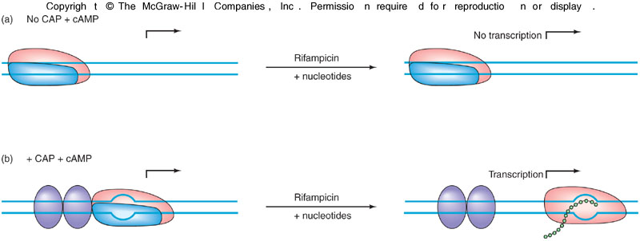
CAP Plus cAMP Action
The open promoter complex does not form even if RNA polymerase has bound the DNA unless the CAP-cAMP complex is also bound
7-57
Notes:
葡萄糖效应又称葡萄糖阻遏或分解代谢产生阻遏作用。葡萄糖或某些容易利用的碳源，其分解代谢产物阻遏某些编码诱导酶体系的基因的转录的现象。如大肠埃希氏菌培养在含葡萄糖和乳糖的培养基上，在葡萄糖没有被利用完之前，乳糖操纵子就一直被阻遏，乳糖不能被利用，这是因为葡萄糖的分解物引起细胞内cAMP含量降低

Slide 58
The Lac Operon:
When Lactose Is Present But Not Glucose
Bind to me
Polymerase
Hey man, I’m
constitutive
Yipee…!
RNA
Pol.
RNA
Pol.
Repressor
CAP
Binding
Promoter
Operator
LacZ
LacY
LacA
CAP
cAMP
X
Repressor
mRNA
Repressor
CAP
Lac
cAMP
Repressor
This lactose has
bent me
out of shape
Repressor
cAMP
CAP
Notes:
constitutive英[kənˈstɪtjutɪv]美[ˈkɑːnstɪtuːtɪv]
adj.组成部分的; 本质的; 基本的;
Constitutive expression 组成型表达

Slide 59
The Lac Operon:
When Glucose Is Present But Not Lactose
Hey man, I’m
constitutive
Come on,
let me through
Lac I
RNA
Pol.
Repressor
CAP
Promoter
Operator
LacZ
LacY
LacA
Binding
Repressor
Repressor
mRNA
No way
Jose!
Repressor
CAP
Notes:
constitutive 英 [ˌkɒnstɪˈtju:tɪv] 美 [ˌkɑ:nstəˈtu:tɪv]

Slide 60
The Lac Operon:
When Neither Lactose Nor Glucose Is Present
Bind to me
Polymerase
Alright, I’m off to
the races . . .
Hey man, I’m
constitutive
RNA
Pol.
Repressor
CAP
Binding
Promoter
Operator
LacZ
LacY
LacA
CAP
Repressor
cAMP
Repressor
mRNA
STOP
Right there
Polymerase
CAP
cAMP
Repressor
cAMP
CAP

Slide 61
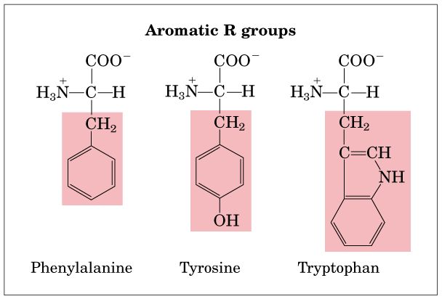
Phe, F, 苯丙氨酸; Tyr, Y, 酪氨酸; Trp, W, 色氨酸

Slide 62
PEP
E – 4 – P
莽草酸 分枝酸
色氨酸 苯丙氨酸 酪氨酸

Slide 63
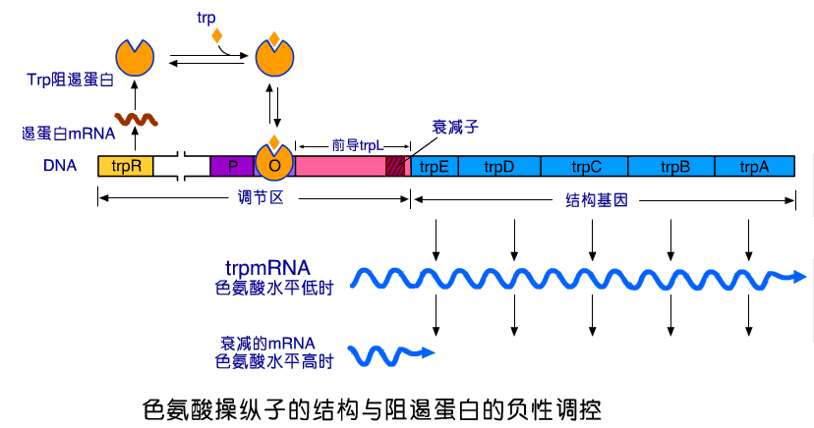
3. The tryptophan operon
attenuator
Notes:
Trp合成途径较漫长，消耗大量能量和前体物，如丝氨酸、PRPP、谷氨酰氨等，是细胞内最昂贵的代谢途径之一，因此受到严格调控，其中色氨酸操纵子发挥着关键作用。调控作用主要有三种方式：阻遏作用、弱化作用以及终产物Trp 对合成酶的反馈抑制作用。
attenuator 英 [əˈtenjueɪtə(r)] 美 [əˈtɛnjuˌetɚ] n. 衰减器

Slide 64
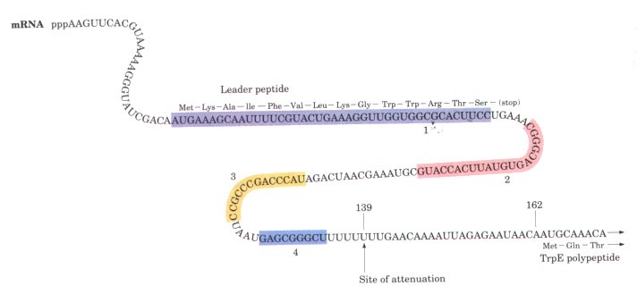
Leader peptide of trp operon
Attenuator (衰减子） (internal terminator), like a trancriptional terminator contains a palindromic GC-rich （回文结构）and a poly (U).
Notes:
理解Trp operon 注意三点
1号片段编码一段多肽，里面有trp密码子
2 ½、/3/4、片段之间存在回文结构，可以相互之间形成互补结果（stem-loop，hairpin结构）
3 原核生物转录、翻译连锁，所以才会造成翻译过程调控转录。
核糖体翻译1号片段时，RNA聚合酶滑动至3号片段（正在转录3号片段）
Trp少时，核糖体停在1号片段，转录出来的2,3之间形成发卡结构，时转录继续
Trp多时，核糖体顺利翻译完成1号片段，占据部分2号片段，转录出来的3号片段不能与2号片段形成发卡，而与随后转录出来的4号片段形成发卡，终止转录。
2,3形成发卡，之后没有富含A,U的序列，所以不容易终止
3,4形成的发卡，之后富含U的序列，是转录容易终止。

Slide 65
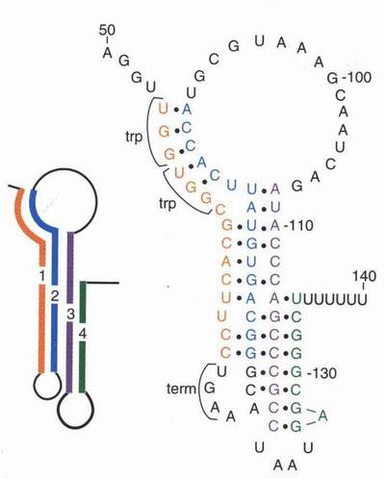
Leader peptide of trp operon

Slide 66
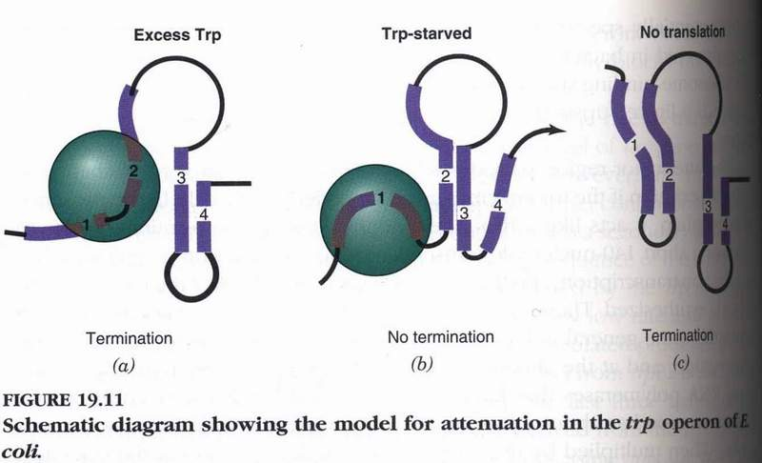
转录、翻译偶联
Terminator
Notes:
attenuation 英 [əˌtenjʊ'eɪʃn] 美 [əˌtenjʊ'eɪʃn] n. 变薄; 弄细; 稀薄化; 减少
先讲b，再讲a，不讲c

Slide 67
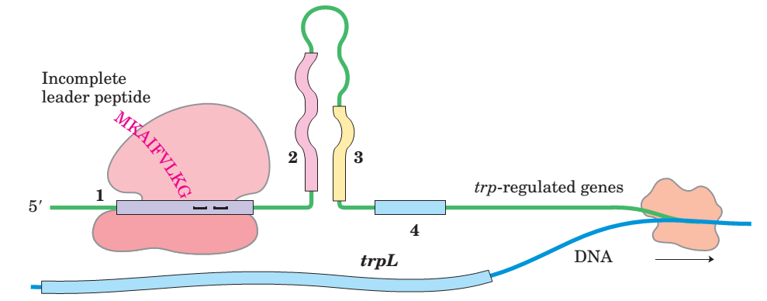
When Trp levels are low, the ribosome pauses at the trp codons in sequence 1. Formation of the paired structure between sequence 2 and 3 prevents attenuation, because sequence 3 is no longer available to form the attenuator structure with sequence 4.

Slide 68
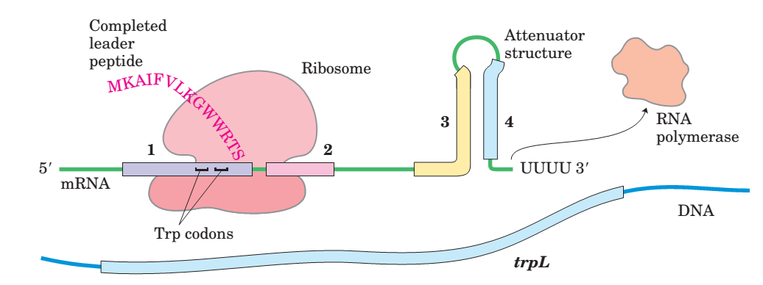
When Trp levels are high, the ribosome quickly translates sequence 1 and blocks sequence 2 before sequence 3 is transcribed. Continued transcription leads to the terminator-like structure formed by sequence 3 and 4

Slide 69
G5 Transcription in Eukaryotes: an Overview
G6 Transcription of Protein-
Coding Genes in Eukaryotes

Slide 70
1. Three kinds of RNA polymerases (I, II, and III) have been revealed for making RNAs in the nucleus of eukaryotic cells
Each is responsible for the transcription of a certain groups of genes: Ribosomal RNA（rRNA）, Messenger RNA （mRNA） or Transfer RNA （tRNA） genes.
The enzymes are often identified by examining their sensitivity towards α-amanitin （鹅膏蕈碱） (from a toxic mushroom).
Notes:
amanitin
英 [ə'meɪnɪtɪn] 美 [ə'meɪnɪtɪn]

Slide 71
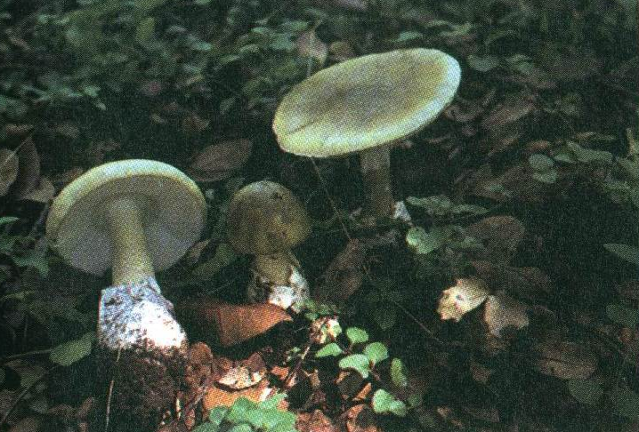
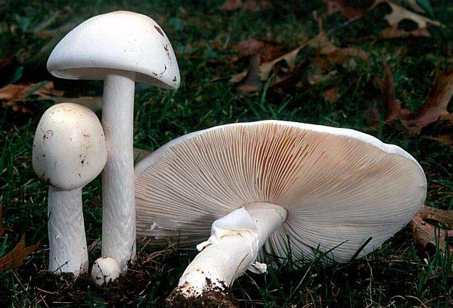
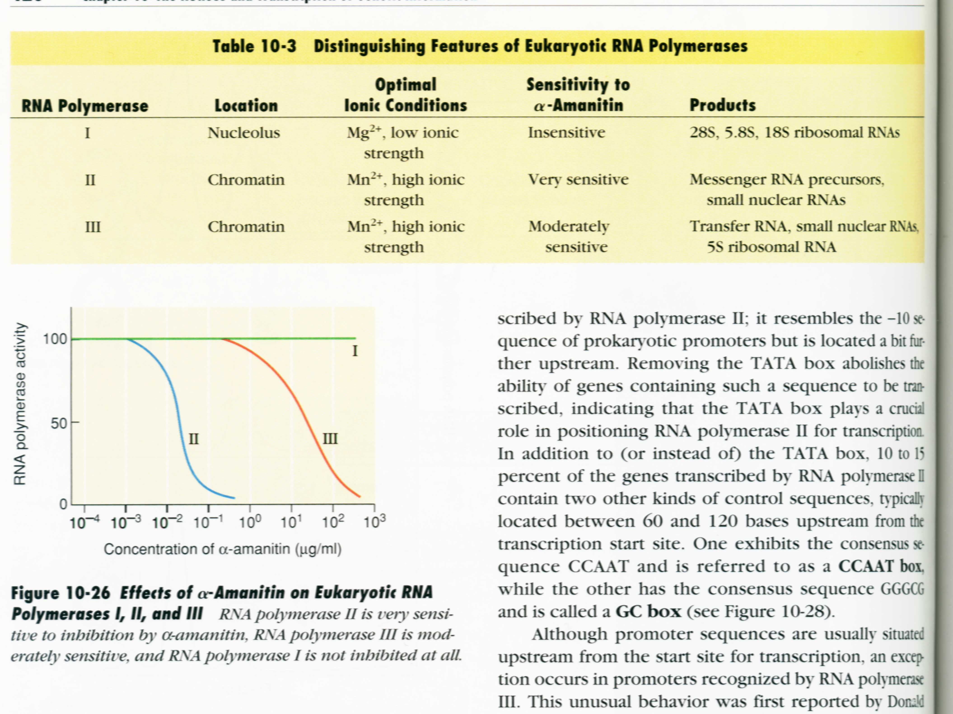
Amanita Phalloides
Amanita bisporigera
insensitive
真核生物RNA聚合酶Ⅰ,Ⅱ,Ⅲ对α-鹅膏蕈素的敏感程度不同。
strongly
sensitive
Inhibited by high concentration
α-鹅膏蕈素对真核生物RNA聚合酶Ⅰ,Ⅱ,Ⅲ的影响

Slide 72
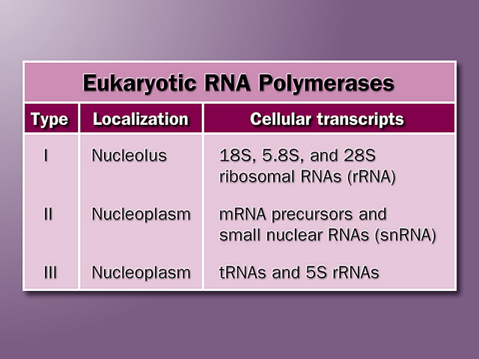

Slide 73
Each of the three RNA polymerases contains 12 or more subunits, some of which are similar to those of E. coli RNA polymerase. However, four to seven subunits in each enzyme are unique to that enzyme.

Slide 74
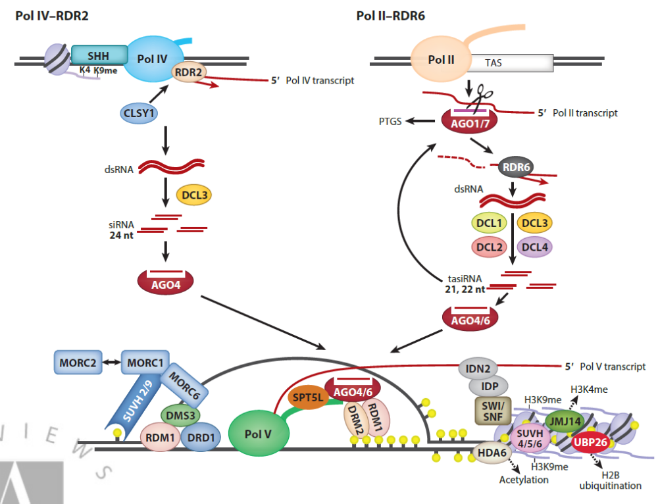
DNA methylation
Heterochromatin
Euchromatin
Pol IV and pol V in plants
Marjori A. et.al 2015, Annu. Rev. Plant Biol.
DOI: 10.1146/annurev-arplant-043014-114633
Notes:
Transposon 转座子
DNA 甲基化 发生在5—甲基胞嘧啶（5—mC）
m6A（N6-methyladenosine，6-甲基腺嘌呤）
小干扰RNA（Small interfering RNA
Chromatin 染色质
Heterochromatin
Euchromatin
RNA-dependent RNA polymerases are not limited to viruses. Enzymes of this type are found in
plants, protists, fungi, and some simpler animals, but not in insects or mammals. Those found in the
genomes of eukaryotes generally play a role in the metabolism of another class of small RNAs, called
small interfering RNAs (siRNAs), which participate in gene regulation 7th p2234 RDR在高等动物中未发现。

Slide 75


Transposon 转座子
麦克林托克
Barbara Mclintock
https://www.163.com/dy/article/HBOAVDSM0512TP34.html
Notes:
1951年Barbara Mclintock首先在玉米中发现了控制元件,后来命名为转座元件或转座子(transposon)。在1983年，她以81岁高龄拿到了迟来的诺贝尔生理学或医学奖。
科研成就在生时没有得到重视，死后被重新发现的有孟德尔、弗兰克林（DNA双螺旋）
孟德尔用心血浇灌的豌豆所告诉他的秘密，时人不能与之共识，一直被埋没了35年之久！
豌豆的杂交实验从1856年至1864年共进行了8年。孟德尔将其研究的结果整理成论文《植物杂交试验》发表，但未能引起当时学术界的重视！其原因有三个。
第一，在孟德尔论文发表前7年（1859年），达尔文的名著《物种起源》出版了。这部著作引起了科学界的兴趣，几乎全部的生物学家转向生物进化的讨论。这一点也许对孟德尔论文的命运起了决定性的作用。孟德尔修士
第二，当时的科学界缺乏理解孟德尔定律的思想基础。首先那个时代的科学思想还没有包含孟德尔论文所提出的命题：遗传的不是一个个体的全貌，而是一个个性状。其次，孟德尔论文的表达方式是全新的，他把生物学和统计学、数学结合了起来，使得同时代的博物学家很难理解论文的真正含义。
第三，有的权威出于偏见或不理解，把孟德尔的研究视为一般的杂交实验，和别人做的没有多大差别。
孟德尔晚年曾经充满信心地对他的好友，布鲁恩高等技术学院大地测量学教授尼耶塞尔说：“看吧，我的时代来到了。”这句话成为伟大的预言。直到孟德尔逝世16年后，豌豆实验论文正式出版后34年，他从事豌豆试验后43年，预言才变成现实。

Slide 76
2. RNA polymerase II (Pol II) binds to promoters of thousands of protein-coding genes
Many Pol II promoters contain a TATAAA sequence (called a TATA box) at -25 (-30) position and an initiator sequence (Inr) at +1 position.
The preinitiation complex (including Pol II) is believed to assemble at the TATA box, with DNA unwound at the
Inr sequence.
However, many Pol II promoters lack a TATA or Inr or both sequences!

Slide 77
Inr

Slide 78


General features of promoters for protein-coding
genes in higher eukaryotes
N A/G/C/T

Slide 79

Inr

Slide 80
3. Pol II is helped by an arrays of protein factors (called general transcription factors(TF)) to form an active transcription complex at a promoter
Firstly, the TATA-binding protein (TBP) binds to the TATA box, then TFIIB, TFIIF-Pol II, TFIIE, and TFIIH (TFII, Transcription Factor for RNA polymerase II) will be added in order forming the closed complex at the promoter.
TFIIH then acts as a helicase to unwind the DNA duplex at the Inr site, forming the open complex.

Slide 81


TFIID for promoter less TATA-Box
DNA
TBP
A proposed
model
for Pol II-
catalyzed
mRNA
synthesis

Slide 82
A kinase activity of TFIIH will phosphoryate the C-terminal domain of Pol II, which will initiate RNA synthesis and release the elongation complex.
TFIIE and TFIIH will be released after the elongation complex moves forward for a short distance.

Slide 83
Transcriptional regulation in a eukaryotic cell is mediated by transcription factors (other than general transcription factors ) which recognize and bind to short regulatory DNA sequences (control elements) associated with the gene. These sequences are also called cis-acting elements (cis-elements) (顺式作用元件）. And the transcription factors are also known as trans-acting factors (反式作用因子）.

Slide 84
The transcription factors regulate specific gene transcription by interacting with the proteins of the transcription initiation complex and either increase or decrease the rate of transcription of the target gene.

Slide 85

Many regulatory elements in a promoter
顺式作用元件(cis-action elements)

Slide 86

Each cis-acting element has a specific sequence composition

Slide 87

TFs contain a DNA-binding domain (BD) and an activation domain (AD)
Notes:
AD是与Pol II的结合结构与吗？不一定，可能是通过中间蛋白激活Pol II, (那么中间蛋白就没有DNA结构与了，它也是TF吗？）

Slide 88

DNA-binding domains
The BD of most of the TFs can forms a specific structure.
zinc finger (锌指）

Slide 89


Basic leucine zipper
一段肽链中每隔7个AA
即有一个Leu，α螺旋
亲水面：亲水AA组成
疏水面：Leu组成
（亮氨酸拉链）
可形成二聚体发挥作用
（同二聚体/异二聚体）
DNA的结合域：
拉链区的氨基端约30AA的碱性区（富含Lys和Arg）

Slide 90


Homeodomain
Helix-turn-helix

Slide 91

Helix-loop-helix

Slide 92
Transcription in Eukaryotes : imitation, elongation, termination
Elongation factors will then join the elongation complex.
Unlike RNA polymerase in prokaryotes, RNA polymerase II does not terminate transcription at specific sites but rather transcription stops at varying distances downstream of the gene with help from termination factors.

Slide 93


Slide 94
In prokaryotes, RNA transcribed from protein-coding genes (messenger RNA, mRNA), requires little or no modification prior to translation
However, mRNA in eukaryotes, ribosomal RNA (rRNA) and transfer RNA (tRNA) are synthesized as precursor molelules that do require post-transcriptional processing) (G7, G8, G9)

Slide 95
G7 Processing of eukaryotic pre-mRNA
The primary transcripts of eukaryotic mRNAs are often capped at the 5` end, spliced（剪接） in the middle (introns removed and exons linked), polyadenylated at the 3` end.

Slide 96

Most protein-coding genes in eukaryotes are discontinuous
Notes:
mature 英 [məˈtʃʊə(r)] 美 [məˈtʃʊr] adj. （人、树木、鸟或动物）成熟的； 仔细考虑过的； 到期（应该支付）的； 成年人的 vi. 成熟，长成； （票据等）到期； vt. 使…成熟； 使…长成； 慎重拟定（计划等）；
ovalbumin英[ˌəʊvæl'bju:mən]美[ˌoʊvæl'bju:mən]n.卵清蛋白，卵白蛋白
oval英[ˈəʊvl]美[ˈoʊvl] adj.椭圆形的; 卵形的;n.椭圆形; 椭圆运动场（等）; 椭圆，美式足球用球; [物] 卵形线;
[例句]He was a man in his late thirties, with fine, dark hair and a pale oval face.
他年近四十，头发乌黑亮泽，长着一张苍白的鹅蛋脸
断裂基因（split gene）

Slide 97

Notes:
adenylation
英 [ədɪnɪ'leɪʃn] 美 [ədɪnɪ'leɪʃn]

Slide 98
The 5’ cap is added before synthesis of the primary transcript is completed.
A noncoding sequence following the last exon is shown in orange.
Splicing can occur either before or after the cleavage and polyadenylation steps.
All of the processes shown here take place within the nucleus.

Slide 99
真核生物中的所有RNA分子在合成后都会在一定程度上进行加工。
有趣的是，催化这些反应的酶有时由RNA而不是蛋白质组成。
催化RNA或核酶的发现为对RNA功能和生命起源的思考带来了一场革命。
Notes:
RNA是生命的起源假说

Slide 100
1. An eukaryotic mRNA precursor acquire a 5` cap shortly after transcription initiates

Slide 101

5` cap
m⁷G^{5’}ppp^{5’}N_{m}pN_{(m)}p--
Notes:
(adoHcy is S-adenosylhomocysteine) 是如何由adoMet变为adoHcy的？
The methyl groups are derived
from S-adenosylmethionine. All these reactions occur
very early in transcription, after the first 20 to 30 nucleotides of the transcript have been added
The 5′ cap is formed by condensation of a molecule of GTP with the triphosphate at the 5′ end of
the transcript. The guanine is subsequently methylated at N-7, and additional methyl groups are often
added at the 2′ hydroxyls of the first and second nucleotides adjacent to the cap (Fig. 26-12a).
7th p2181

Slide 102


Slide 103






何为Homocysteine？
Homocystine
Homocysteine
homocysteine
Notes:
有的文献homocysteine
homocysteine
n.高半胱氨酸;
homocystine
n.高半胱氨酸；同型半胱氨酸;
SAM转甲基后水解,生成高半胱氨酸,也称为同型半胱氨酸(homocysteine,Hcy)

Slide 104

Notes:
在转录的早期，在添加转录本的前 20 到 30 个核苷酸之后
图 26-12 mRNA 的 5′ 帽。（a） 7-甲基鸟苷 （m7G） 与几乎所有真核生物的 5' 端相连
mRNA 处于不寻常的 5'，5'-三磷酸键中。甲基（浅红色）通常位于第一个和
第二核苷酸。酵母细胞中的RNA缺乏2′-甲基。第二个核苷酸上的 2′-甲基是
通常只存在于脊椎动物细胞的RNA中。（b） 5′帽的产生需要四个独立的步骤（adoHcy是唾腺苷同型半胱氨酸）。（c） 帽的合成是通过拴在Pol II的CTD上的酶进行的。上限仍然存在
通过与帽结合复合物 （CBC） 的结合与 CTD 相连
第 7 页 p2186

Slide 105
The terminal 5` phosphate is first removed by a phosphatase.
A GMP component (from a GTP) is joined to the 5` end of the mRNA catalyzed by guanosyl transferase in a novel 5`,5`-triphosphate linkage.
The guanine base is then methylated at the N-7.
The 2`-OH groups of the 1st and 2nd nucleotides adjacent to the 7-methylguanine cap may also be methylated in certain organisms.
The methyl groups are transferred from S-adenosyl methionine（SAM S-腺苷甲硫氨酸）.
Notes:
phosphatase 英 ['fɒsfəteɪs] 美 ['fɒsfəˌteɪs] n. 磷酸（酯）酶；
hydroxyl 英 [haɪ'drɒksɪl] 美 [haɪ'drɒksɪl] n. 羟（基）氢氧基； 羟基；
methionine 英 [me'θaɪəni:n] 美 [mə'θaɪəˌni:n] n. 蛋氨酸，甲硫氨酸
S-腺苷基甲硫氨酸（英语：S-adenosyl methionine，缩写为SAM

Slide 106
A poly(A) tail is usually added at the 3` end of an mRNA molecule via a processing step.
Notes:
问题：polyadenylate polymerase 具有endonuclease activity吗？不是polymerase具有的endonuclease，是同在一个complex的其他蛋白具有的endonuclease

Slide 107

Notes:
图 26–17 将 poly（A） 尾添加到真核生物的初级 RNA 转录本中。Pol II 合成的 RNA 超出了
包含切割信号序列的转录本，包括高度
保守的上游序列（5'）AAUAAA。该切割信号序列由包含核酸内切酶的酶复合物结合，
一种聚腺苷酸聚合酶，以及参与序列识别、刺激切割和调节
poly（A） 尾巴的长度，所有这些都拴在 CTD 上。1 已将
RNA 在 10 至 30 个核苷酸 3'to（下游）序列 AAUAAA 处被核酸内切酶切割。2 聚腺苷酸聚合酶合成一个 80 至 250 个核苷酸长的 poly（A） 尾，开始
在解理部位。

Slide 108
3. The introns transcribed into RNA are removed by splicing

Slide 109



Demonstration of noncoding sequences in the chicken ovalbumin gene by RNA-DNA hybridization
Notes:
ovalbumin
英 [ˌəʊvæl'bju:mən] 美 [ˌoʊvæl'bjumən]
n. 卵清蛋白，卵白蛋白；

Slide 110


Slide 111
4. Introns are self-splicing and the ends of the exon sequences ligate together
The intron is removed and the two exons precisely linked to produce a functional mRNA molecule in Eukaryotes.

Slide 112
Four classes of introns
self-splicing
no
high-energy (ATP) for splicing
Group I introns nuclear, mitochondrial, and chloroplast
genes that code for rRNAs,
mRNAs, and tRNAs.
Group II introns mitochondrial or chloroplast mRNAs
in fungi, algae, and plants.
Group III introns
Group IV introns
Group III: the spliceosomal introns
spliceosome (protein complex) , containing:
small nuclear RNAs
(snRNAs) : Five snRNAs (U1, U2, U4, U5, and U6)
small nuclear ribonucleoproteins (snRNPs)
Group IV: found in certain tRNAs, requires ATP and an endonuclease.
Notes:
Self-splicing of introns was first revealed in 1982 instudies of the splicing mechanism of the group I rRNA
intron from the ciliated protozoan Tetrahymena thermophila
In eukaryotes, most introns undergo splicing by the same lariat-forming mechanism as the group II
introns. However, the intron splicing takes place within a large protein complex called a
spliceosome, and these introns, the spliceosomal introns, are not assigned a group number. （啥意思，这些不属于group iii，iv吗？）
GROUP IV:found in certain tRNAs, is distinguished from the group I and II
introns in that the splicing reaction requires ATP and an endonuclease. The splicing endonuclease
cleaves the phosphodiester bonds at both ends of the intron, and the two exons are joined by a
mechanism similar to the DNA ligase reaction
algae
TOEFL/IELTS
英[ˈældʒiː]
美[ˈældʒiː]
ribonucleoprotein
英[raɪbəʊnjʊkli:əʊ'prəʊti:n]
美[ˌraɪboʊˌnjuklioʊ'proʊtin]
释义
n.核蛋白（
Group III: In eukaryotes, most introns undergo splicing by the same lariat-forming mechanism as the group II introns. However, the intron splicing takes place within a large protein complex called a spliceosome, and these introns, the spliceosomal introns, are not assigned a group number.
spliceosome (protein complex) , containing:
small nuclear RNAs
(snRNAs) : Five snRNAs (U1, U2, U4, U5, and U6)
small nuclear ribonucleoproteins (snRNPs)
Spliceosomal introns generally have the dinucleotide sequence GU at the 5′ end and AG at the 3′end (U1, U2).
Some mRNA introns are spliced by a less common type of spliceosome with (5′)AU and AC(3′) terminal sequences to mark the splice sites (U11, U12).
The spliceosomes used in nuclear RNA splicing almost certainly evolved from more ancient
group II introns, with the snRNPs contributing much greater levels of catalytic flexibility and
regulation relative to their self-splicing ancestors

Slide 113
Splicing mechanism of group I introns
GMP
Notes:
图 26–14 Iintrons群的剪接机制。第一步中的亲核试剂可能是
鸟苷、GMP、GDP 或 GTP。拼接的内含子甚至降解。
内含子的自剪接于1982年在对内含子剪接机制的研究中首次被发现。
来自纤毛原生动物嗜热四膜虫的I组rRNA内含子，由Thomas进行
切赫和同事们。这些工作人员转录了分离的四膜虫DNA（包括内含子）
体外，使用纯化的细菌RNA聚合酶。得到的RNA可以准确地剪接自身，而无需
来自四膜虫的任何蛋白质酶。

Slide 114
Splicing mechanism of group II introns
Notes:
FIGURE 26–15 Splicing mechanism of
group II introns. The chemistry is similar
to that of group I intron splicing, except
for the identity of the nucleophile in the
first step and formation of a lariat like
intermediate, in which one branch is a
29,59-phosphodiester bond.
问题：self-splicing 说明intron本身是核酶吗？是的
The resulting RNA spliced itself accurately without any protein enzymes
from Tetrahymena. The discovery that RNAs could have catalytic functions was a milestone in our understanding of biological systems.

Slide 115

Splicing mechanism with spliceosome complexes
Notes:
ATP is需要组装剪接体，但 RNA 切割-连接反应
不需要 ATP。一些 mRNA 内含子由一种不太常见的剪接体剪接，其中
U1 和 U2 snRNP 被 U11 和 U12 snRNP 取代。而含有 U1 和 U2 的
剪接体去除具有（5′）GU和AG（3′）末端序列的内含子，如图26-16所示，
含有 U11 和 U12 的剪接体去除了一类罕见的内含子，这些内含子具有 （5′）AU 和
AC（3′） 末端序列来标记剪接位点。
图 26–16 mRNA 初级转录本的剪接机制。（a） 剪接体复合物形成中的RNA配对相互作用。U1 snRNA 在其 59 端附近具有酶序，与内含子 59 端的剪接位点互补。U1 与主转录本的该区域的碱基配对有助于定义
剪接体组装过程中的59个剪接位点（是假尿苷;见图26-22）。
U2 在包含 A 残基（阴影光）的位置与内含子配对
红色），在剪接反应过程中成为亲核试剂。U2 的碱基配对
snRNA引起隆起，移位并帮助激活腺苷酸，即29
其中的OH将通过29,59-磷酸二酯键形成套板结构。
（b） 剪接体的组装。U1 和 U2 snRNP 结合，然后剩余的 snRNP（U4-U6 复合物和 U5）结合形成无活性剪接体。
内部重排将该物种转化为活性剪接体，其中
U1 和 U4 已被驱逐，U6 与 59 拼接位点和
U2 中。接下来是催化步骤，其与剪接步骤平行
第二组内含子（见图26-15）。
（c） 剪接和转录的协调使两个剪接位点
一起。有关详细信息，请参阅正文。剪接体比指示的要大得多
这里。

Slide 116

R- purine 嘌呤
Y- pyrimidine 嘧啶
Group III
UACUAAC
Notes:
核酶是指的intron本身吗？还是指的其他的RNA是核酶？

Slide 117

Group III
2’-5’ phosphodiester bond

Slide 118
RNA剪接分两个步骤进行：
内含子中特定腺苷的 2'OH 充当亲核试剂，攻击 5' 剪接位点以形成套板结构。
5'外显子的 3'OH 充当亲核试剂，完成反应
在两个剪接反应中的每一个中，一个磷酸酯键被交换为另一个磷酸酯键。
Notes:
nucleophile 英 ['nju:klɪəfaɪl] 美 ['nju:kli:əˌfaɪl] n. 亲核试剂
lariat 英 ['lærɪət] 美 ['lærɪrt] n. （套捕马、牛等用的） 套索

Slide 119
RNA splicing requires the involvement of several small nuclear RNAs (snRNA) each of which is associated with several proteins to form a small nuclear ribonucleoproteins
particle or snRNP(a large protein complex called a spliceosome )

Slide 120
5.Mutiple products are derived from one gene by differential RNA processing
The transcription of introns consumes cellular resources and energy without returning any obvious benefit to the organism, but introns may confer an advantage not yet appreciated by scientists.
Although most eukaryotic mRNA transcripts produce only one mature mRNA and one corresponding polypeptide, some can be processed in more than one way to produce different mRNAs and thus different polypeptides.

Slide 121


Multiple mRNAs can be produced via differential RNA processing.

Slide 122
In Fig. a, alternative cleavage and polyadenylation patterns.
Two ply(A) sites, A1 and A2, are shown.
In Fig. b, alternative splicing patterns.
Two different 3’ splice sites are shown. In both mechanisms, different mature mRNAs are produced from the same primary transcript.

Slide 123
6. The sequence of an RNA molecule may be changed after synthesis and processing
Individual nucleotides within the mRNA may be changed to other mucleotides, deleted entirely or additional nucleotides inserted. The effect of RNA editing is to change the coding capacity of the mRNA so that it encodes a different polypeptide than that originally encoded be the gene.

Slide 124

CAA =gln
UAA =stop
Notes:
apolipoprotein 英 [ˌæpəˌlɪpə‘prəʊtɪn] 美 [ˌæpəˌlɪpə’proʊtɪn] 载脂蛋白
CAA =gln
UAA =stop

Slide 125



Slide 126

2015.12-2018.2
10 papers

Slide 127

Today 2019.10.28
40 papers

Slide 128

Today 2020.10.29
44 Papers

Slide 129

2022.10.27
767 Papers

Slide 130
G8 Ribosomal RNA

Slide 131

1. Ribosomes
沉降系数S

Slide 132

28S, 5.8S, 5S
80S
18S

Slide 133


Slide 134
2. The different rRNA molecules of both prokaryotes and eukaryotes are generated from single pre-rRNAs
The 16S, 23S and 5S rRNAs in bacteria are all generated from a single 30S pre-rRNA (about 6.5 kb).
The 18S, 28S and 5.8S rRNAs in eukaryotes are generated from a single 45S pre-rRNA (~14 kb).
The 5S rRNA in eukaryotic cells is generated separately (transcribed by RNA polymerase III).

Slide 135

Notes:
nuclease 英 ['nju:klɪeɪs] 美 ['nju:kəlɪˌeɪs]
n. 核酸酶
Cleavage liberates precursors of rRNAs and tRNA(s).
Cleavage at the points labeled 1, 2, and 3 is carried
out by the enzymes RNase III, RNase P, and RNase E,
respectively. As discussed later in the text, RNase P is a
ribozyme.

Slide 136

The 18S, 5.8S, and 28S rRNAs in eukaryotic cells are
derived from one pre-rRNA molecule (the processing
needs small nucleolar RNA-containing proteins).
Notes:
nucleolar 英 [nju:'kli:ələ] 美 [nju:'kli:ələ] adj. 核仁的
The cleavage reactions and all of the modifications require small nucleolar RNAs (snoRNAs)
found in protein complexes (snoRNPs) in the nucleolus that are reminiscent of spliceosomes. The 5S rRNA is produced separately

Slide 137
3. More RNA molecules (ribozymes) were found to be catalytic

Slide 138
The M1 RNA
in ribonuclease
P is catalytic
The intron in
the pre-rRNA of
Tetrahemena
is self-spliced
Notes:
在研究细菌tRNA的合成中，发现RNA具有催化作用，为此，1989年获诺贝尔化学奖。

Slide 139
G9 Transfer RNA

Slide 140
Notes:
cloverleaf 英 [ˈkləʊvəli:f] 美 [ˈkloʊvərli:f]
n. （道路的） 苜蓿叶式立体交叉，四叶式立体交叉

Slide 142
Cloverleaf secondary structure of tRNA
stem
T loop
D loop
Variable arm
Anticodon loop

Slide 143
Notes:
粉色标注的为什么变了，D变成了Pu， Pu是什么意思？是Purine吗？

Slide 144
The function of tRNA
结合氨基酸
识别氨酰-tRNA合成酶
识别核糖体
反密码区正中的3个核苷酸残基可以与mRNA的三联体密码子形成碱基互补配对，解读遗传密码，称为反密码子（anticodon）。

Slide 145
Tertiary structure of tRNA

Slide 146

1. Primary tRNA transcripts undergo a series of posttranscriptional processing
Notes:
RNase D is protein；
Ribonuclease P (EC 3.1.26.5, RNase P) is a type of ribonuclease which cleaves RNA

Slide 147
Primary tRNA posttranscriptional processing
The extra sequences at the 5` and 3` ends are removed by RNase P and RNase D respectively. Intron sequences are spliced.
The CCA sequence is generated at the 3` end.
Some of the bases in tRNA molecules are modified by methylation, deamination, reduction and others.
Notes:
deamination 英 [di:æmɪ'neɪʃən] 美 [di:æmɪ'neɪʃən]
n. 去氨基

Slide 148

4-硫尿苷
次黄（嘌呤核）苷，肌苷
异戊烯腺苷
. 假尿（嘧啶核）苷
二氢尿嘧啶核苷
Some typical modificied bases found
In mature tRNA molecules.
Notes:
thiouridine 英 ['θɪəraɪdɪn] 美 ['θɪəraɪdɪn] [词典] [医] 硫尿核苷
inosine 英 ['ɪnəsi:n] 美 ['aɪnəˌsi:n] n. 次黄（嘌呤核）苷，肌苷
isopentenyladenosine 英 [aɪsəʊpəntənəleɪdɪnəʊ'zɪn] 美 [aɪsoʊpəntənəleɪdɪnoʊ'zɪn] [词典] [医] 异戊烯腺苷
thymidine 英 ['θaɪmədɪn] 美 ['θaɪmədɪn] n. 胸（腺嘧啶脱氧核）苷
dihydrouridine 英 [di:'haɪdrəraɪdɪn] 美 [di:'haɪdrəraɪdɪn]二氢尿嘧啶核苷
pseudouridine 英 [sju:dəʊ'jʊərɪdi:n] 美 [sju:doʊ'jʊərɪdi:n] n. 假尿（嘧啶核）苷

Slide 149


6
1
5
7
2
8
4
9
3
4
3
5
2
1
6

Slide 150
RNA 指导下的RNA和DNA的合成
RNA dependent synthesis of DNA and RNA

Slide 151
Reverse transcriptases catalyze the production of DNA from RNA
This enzyme catalyzes three reactions:
  RNA-directed DNA synthesis using tRNAs as primers;
  Degradation of the RNA template;
  DNA-directed DNA synthesis;
The enzyme has no 3`- 5` proofreading exonuclease activity, thus generating high rate of mutations.
This enzyme is widely used to synthesize complementary DNAs (cDNAs) from mRNAs.

Slide 152

逆转录病毒

Slide 153
Some viral RNAs are replicated by RNA-directed RNA polymerase
The RNA genomes of some viruses are replicated using RNA-directed RNA polymerases (or RNA replicases).
The RNA replicase consists of subunits encoded both by the viruses and the host genome.
They have features similar to that of DNA-directed RNA polymerases, but are usually specific for the RNA of the specific viruses.

Slide 154
Summary
Transcription shares the basic chemical mechanisms with replication except: no primers required, no proofreading activity exist.
Transcription begins at specific promoter sequences and ends at specific terminator sequences (being ρ -independent or dependent in bacteria).
One multimeric RNA polymerase catalyzes the synthesis of all the RNA molecules in bacteria and different RNA polymerases are used to synthesize the different types of RNAs in eukaryotes.

Slide 155
Primary RNA transcripts are further processed: capped, tailed, spliced and sometimes edited for the mRNAs; ends removed and modified, bases modified for the tRNAs; cleaved and sometimes spliced for the rRNAs.
DNA can be synthesized by using RNA as templates in a reaction catalyzed by reverse transcriptase.
RNA is very likely the first type of biomacromolecules produced during biochemical evolution.
RNA replicase catalyzes the synthesis of RNA from RNA templates.

Slide 156
Summary of RNA transcription
G1 RNA structure: tRNA cloverleaf
G2 RNA Transcription in Prokaryotes
1. similar and different aspects between DNA replication
and RNA transcription
2. RNA polymerase
3. transcriptional bubble
4. promoter
5. RNA transcription: initiation, elongation, termination
G3 the Lac operon
G5,G6 Transcription in Eukaryotes
1. Three RNA polymerases
2. Pol II binding promoter, transcription factor
G7 Processing of eukaryotic pre-mRNA
1. mRNA processing
2. rRNA processing
3. tRNA processing

Slide 157
END
Thank you

Slide 158

Notes:
人类基因组中，大部分microRNAs位于内含子。microRNA对于调控基因的表达具有重要意义。

Slide 159


Reverse transcriptases catalyzes the
sythesis of DNA from RNA template.

Slide 160


Slide 161

关于沉降系数S

Slide 162


Slide 163


Slide 164

Enhancers (upstream activator sequences (UASs) in yeast)
Although many positive control elements lie close to the gene they regulate, others can be located long distances away (10-50kb) either upstream or downstream of the gene.

Slide 165
Repressors
Repressors near the gene called negative regulators.
Repressors long distance away from the gene called silencers (沉默子）.

Slide 166

TBP: TATA-Binding Protein;

Slide 167

Regulation of transcription at genes of galactose
metabolism in yeast.

Slide 168

Protein complexes involved in transcription activation of a group of related eukaryotic genes

Slide 169

Model of Formation of the DABPolF Complex
11-169
Notes:
At promoters lacking a TATA box, TBP arrives as part of a
multisubunit complex called TFIID (not shown in Fig.
26–9). The sequence elements that direct the binding of
TFIID at TATA-less promoters are poorly understood

